Slide 1
The single-cell transcriptome landscape in human tissues
11/20/2019
Notes:
大家好，今天我总结一下目前的一些进展。

Slide 2
Content
Part1: Overview of GeACT
Part2: Cell type identification and annotation
Part3: Transcriptional regulation across cell-types
Part4: Co-expression modules within each cell type
Part5: The spatial - specific expression
Notes:
Figure tissues:
Figure 96-well plate:
Figure NGS: https://coursesandconferences.wellcomegenomecampus.org/our-events/next-generation-sequencing-2019/

Slide 3


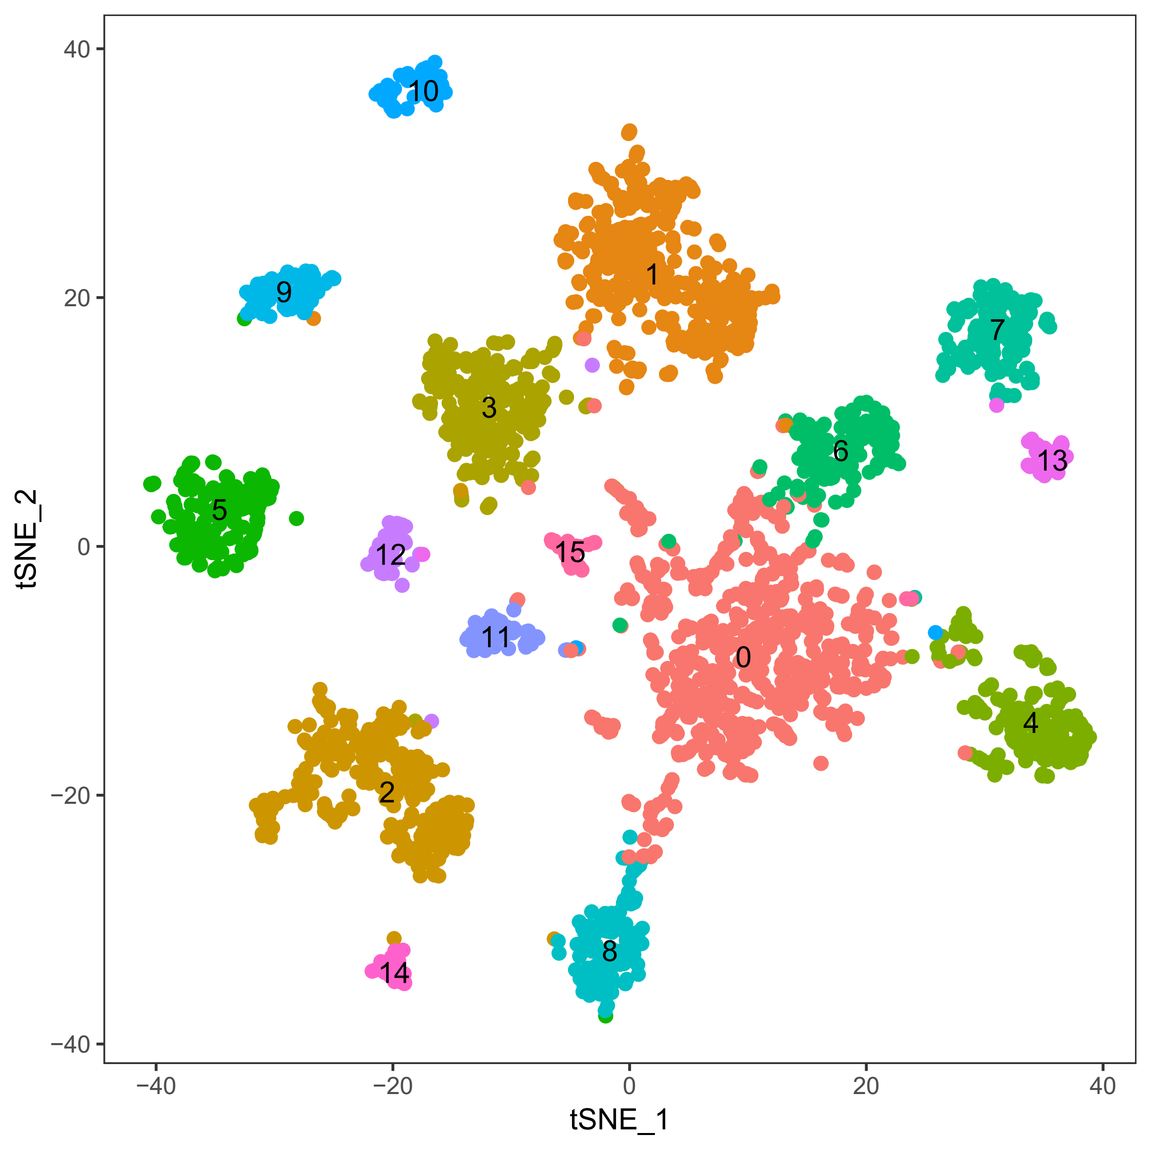






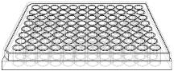
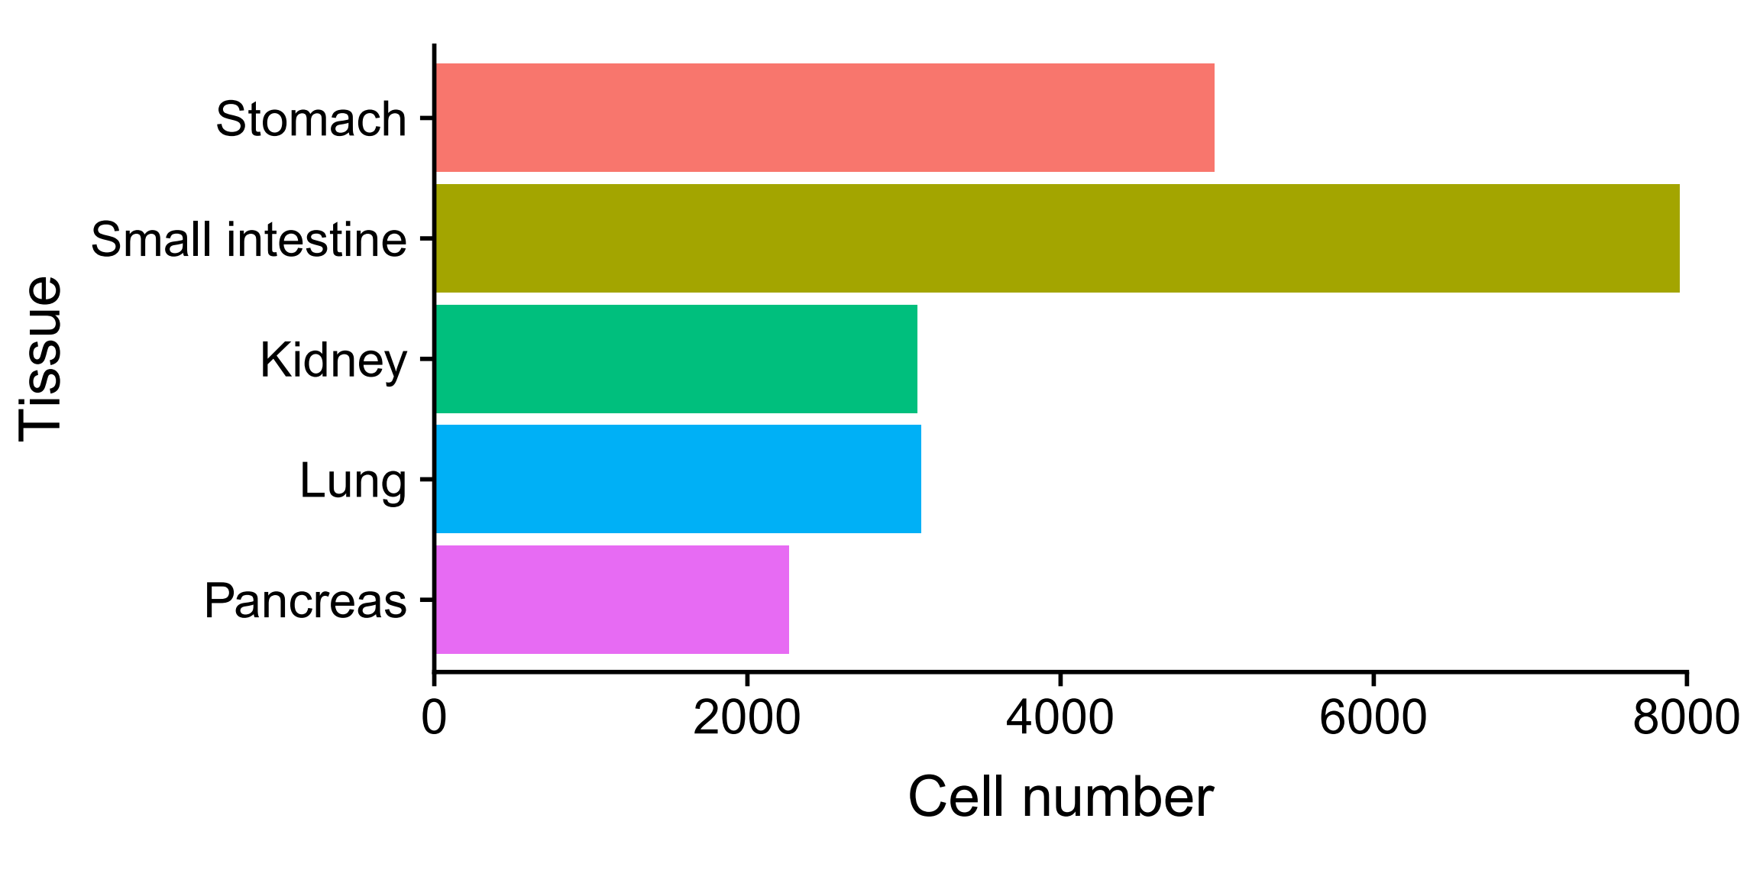
Part1: Overview of GeACT
A
Sampling
FACS sorting
Sequencing
Data analysis
B
sc-RNA-seq (21,395)
C
Notes:
Figure tissues:
Fetal: https://www.google.com.hk/imgres?imgurl=https%3A%2F%2Fimage.shutterstock.com%2Fimage-vector%2Ffetus-icon-isolated-on-white-260nw-363954884.jpg&imgrefurl=https%3A%2F%2Fwww.shutterstock.com%2Fsearch%2Ffetus%2Bicon&tbnid=Cq6mCP3U-dWppM&vet=12ahUKEwiW86P4mInlAhUC25QKHQF9CF0QMygAegQIARAr..i&docid=ZAwkagmo_JS0WM&w=260&h=280&q=human%20fetal%20icon&hl=zh-cn&safe=strict&ved=2ahUKEwiW86P4mInlAhUC25QKHQF9CF0QMygAegQIARAr
Small intestinal: https://www.google.com.hk/search?q=small+intestine+icon&tbm=isch&ved=2ahUKEwi0mur_nYnlAhWPDt4KHdyaDD0Q2-cCegQIABAA&oq=small+intestine+icon&gs_l=img.3..35i39.63803.64205..64581...0.0..0.182.713.0j4......0....1..gws-wiz-img.......0i30.NJicx3SltVU&ei=trSaXbTnMY-d-AbctbLoAw&bih=937&biw=1920&safe=strict&hl=zh-cn#imgrc=07HieIZfCRS_gM
Ovary: https://thenounproject.com/term/ovary/131059/
Figure 96-well plate:
Figure NGS: https://coursesandconferences.wellcomegenomecampus.org/our-events/next-generation-sequencing-2019/

Slide 4
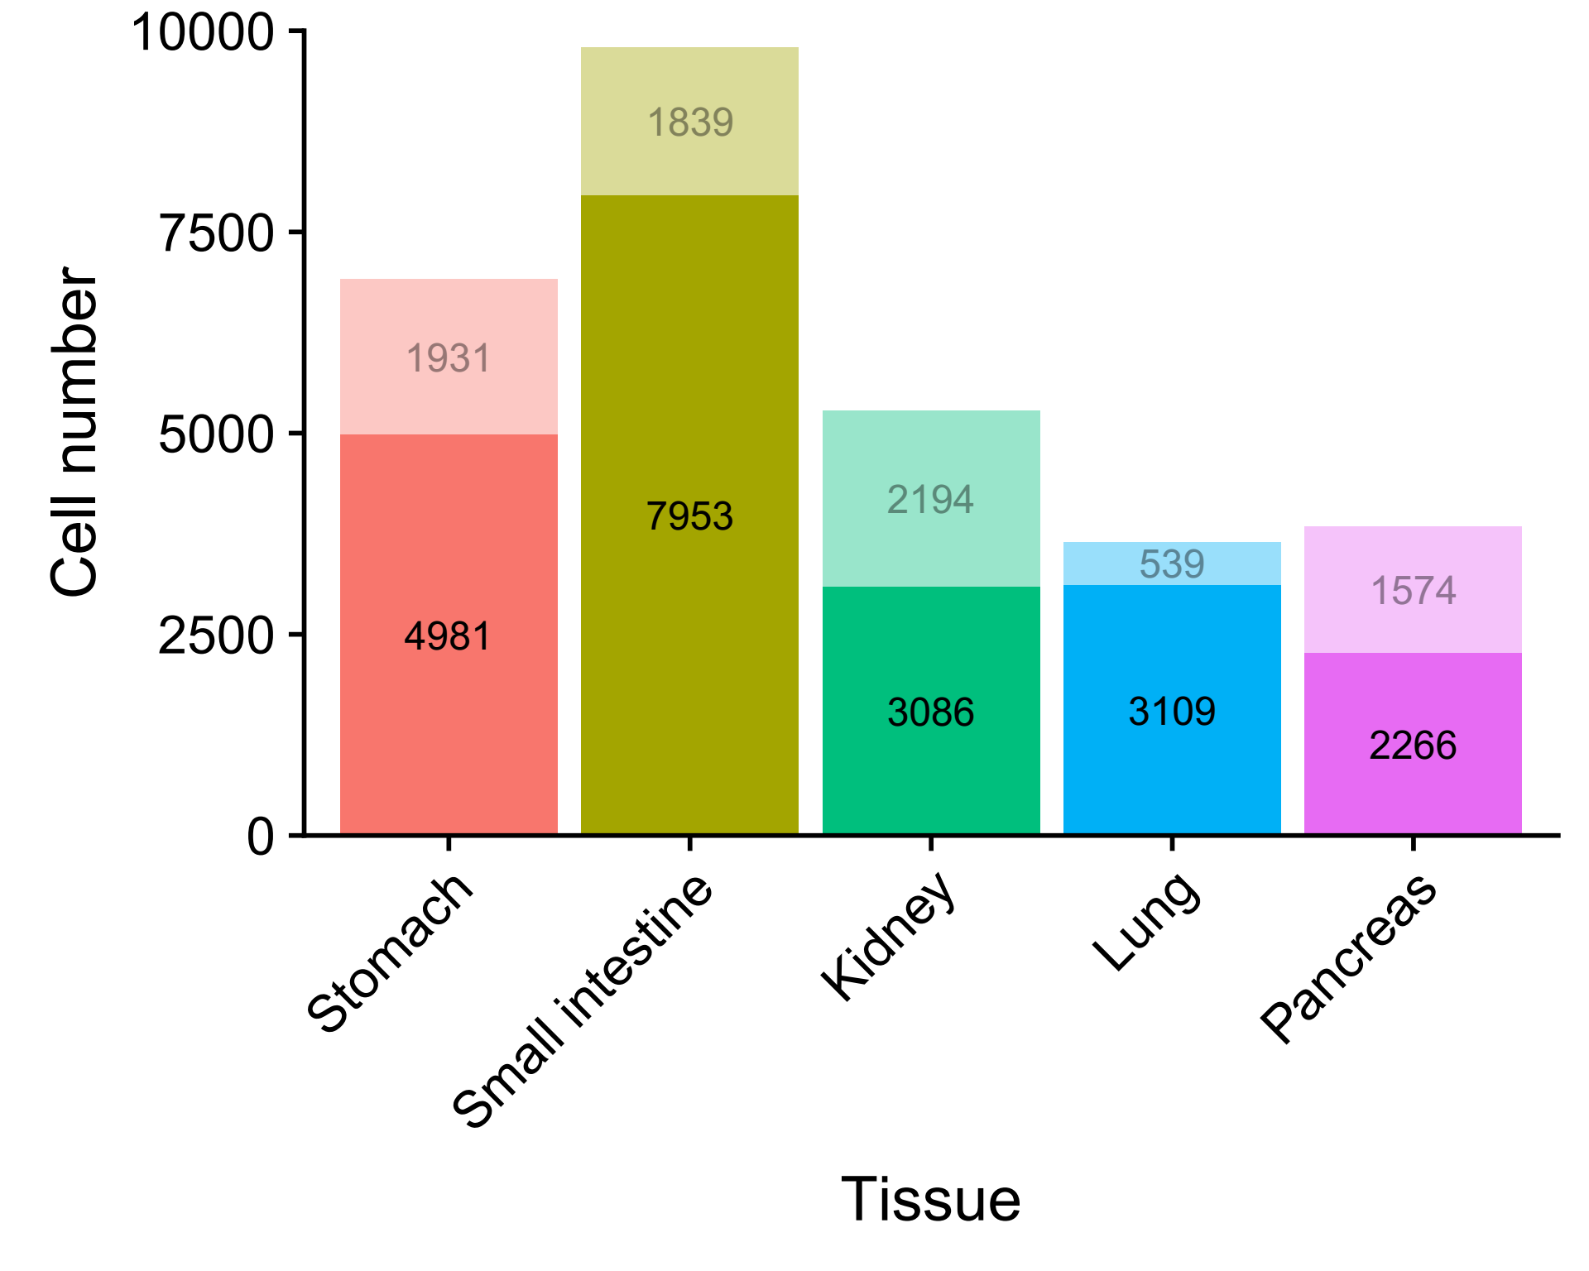
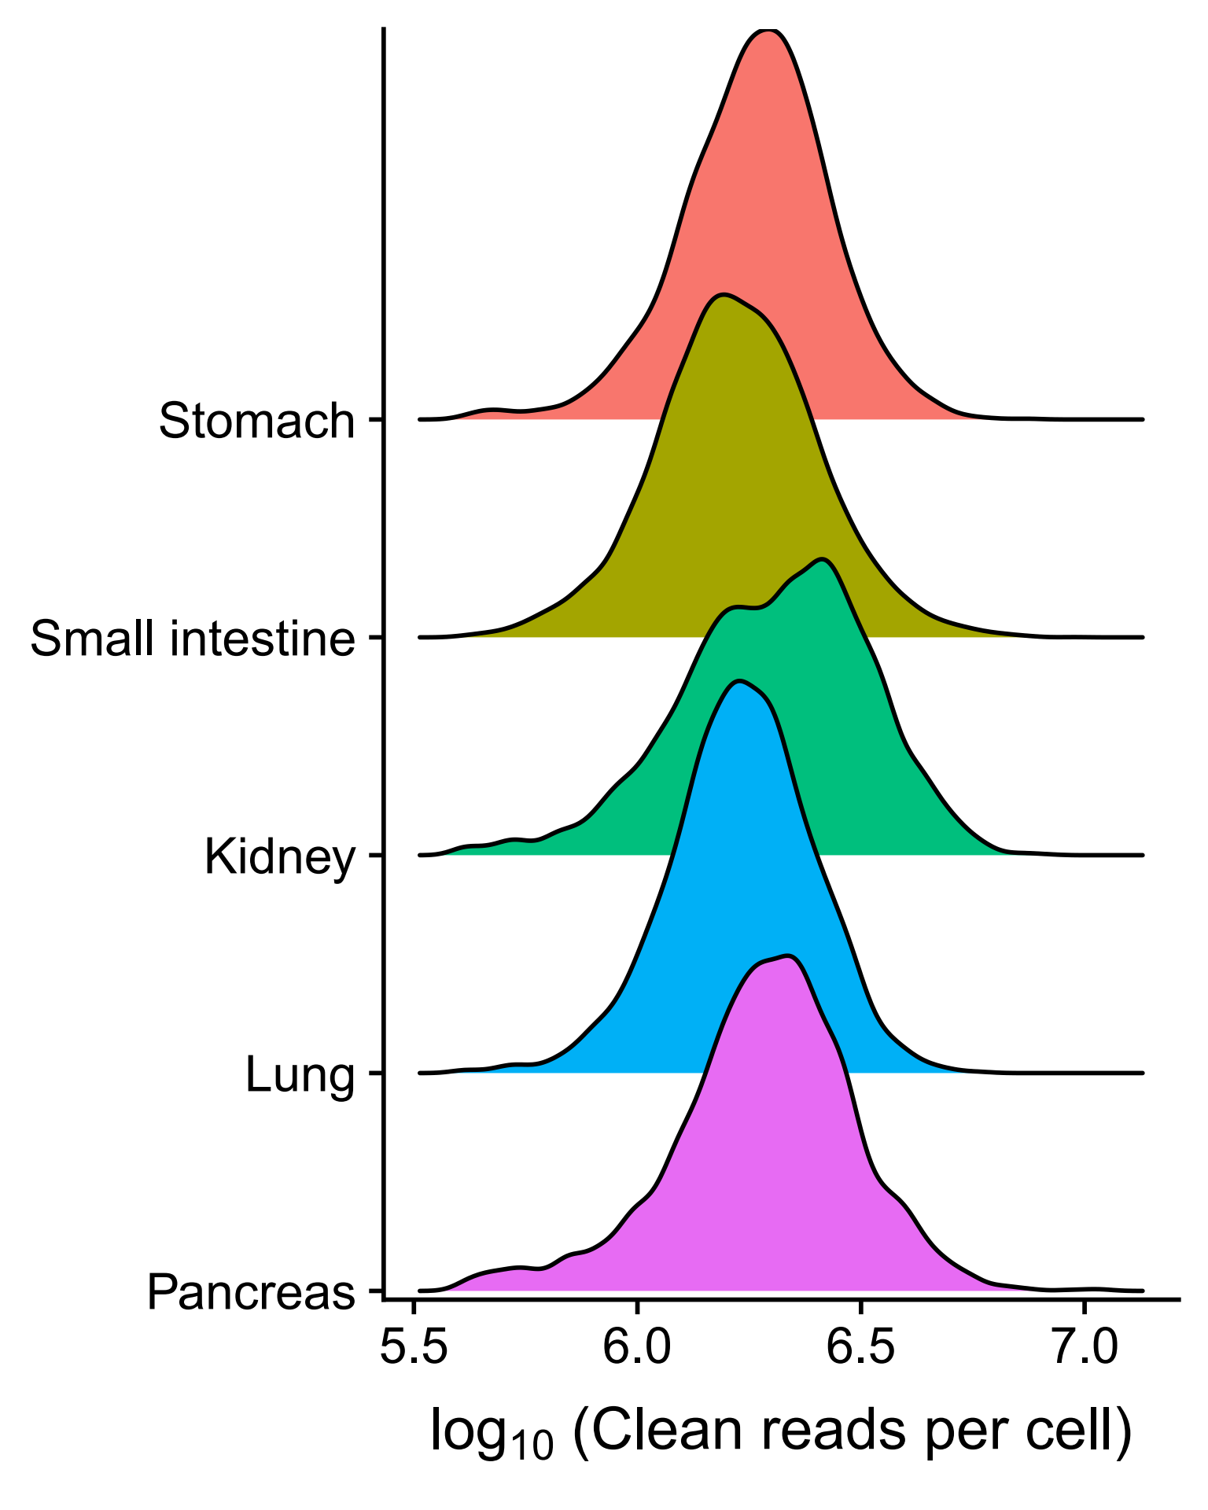
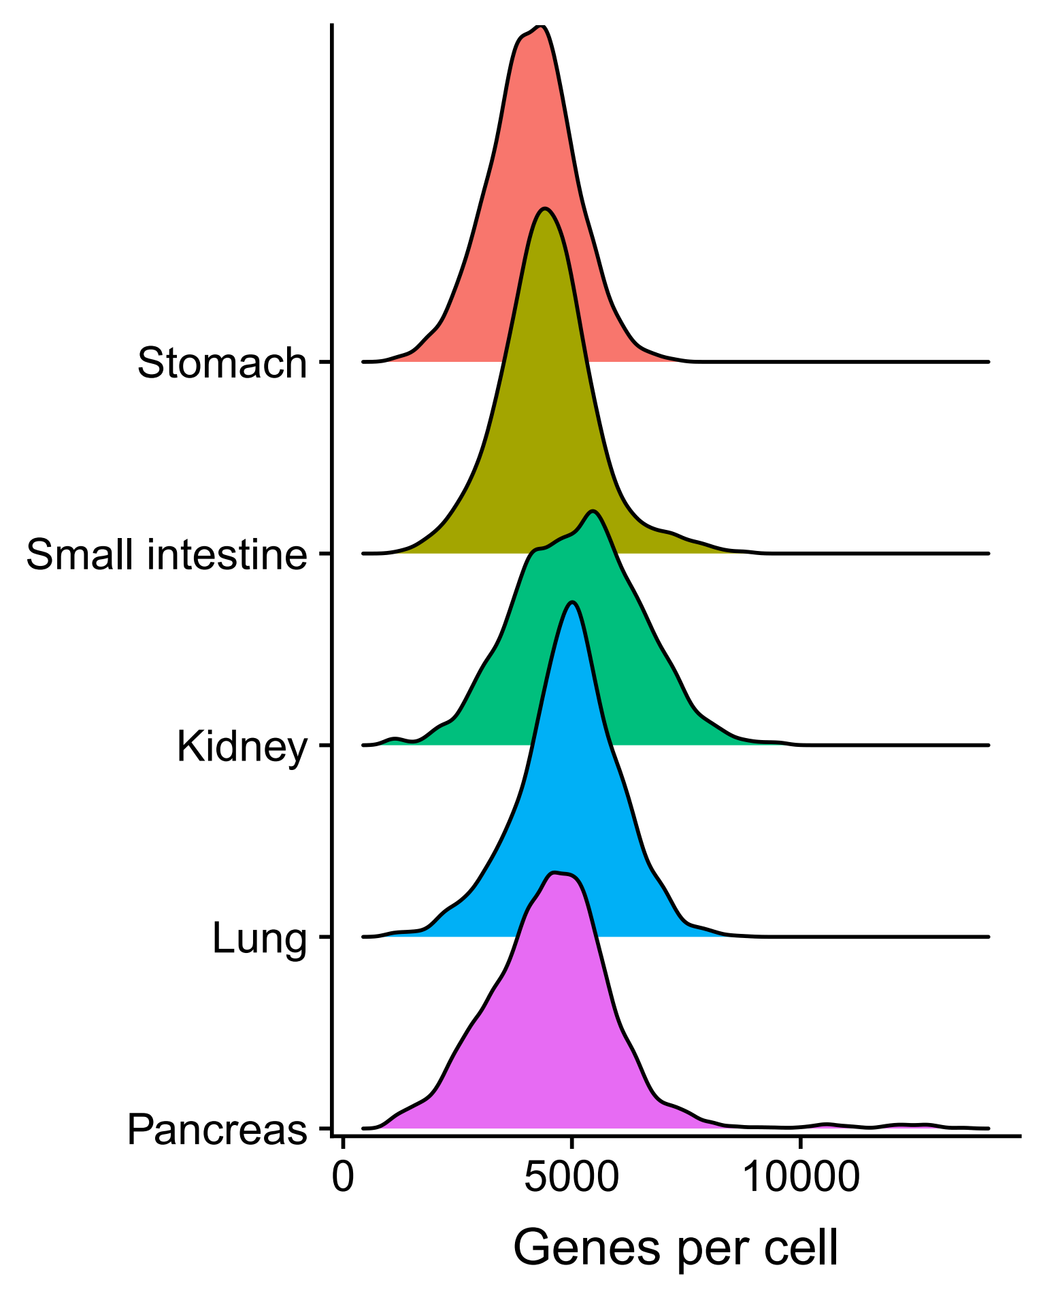
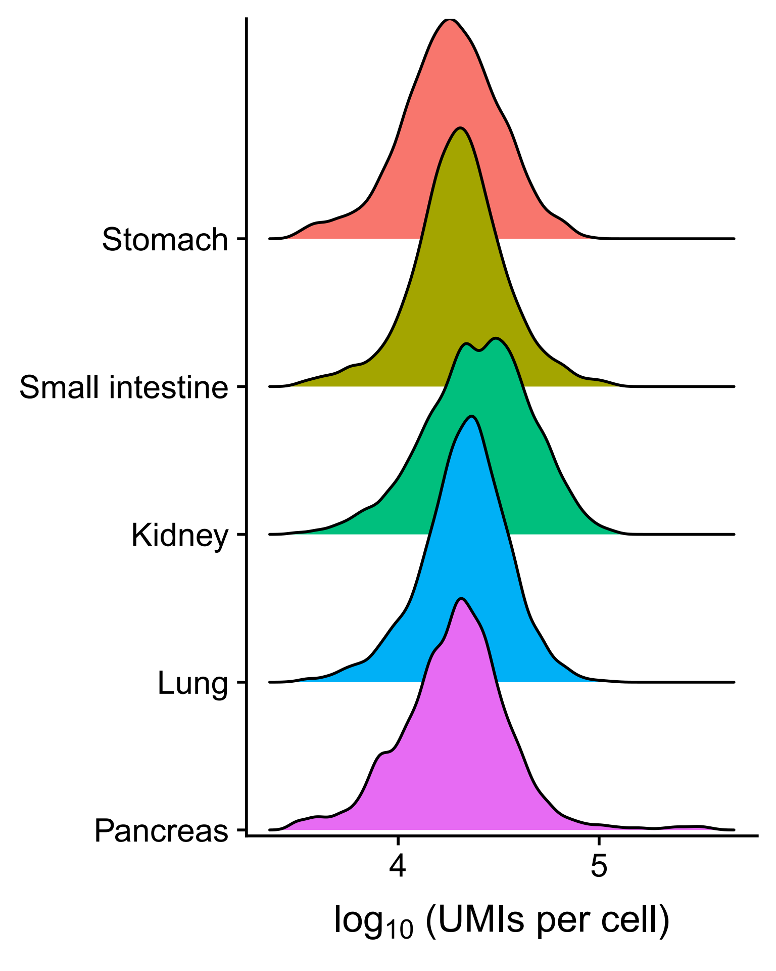
Part1: Overview of GeACT
A
B

Slide 5
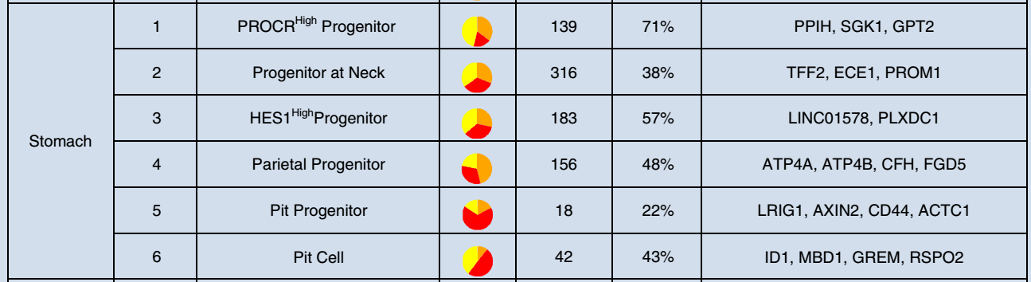
Stomach: cell type identification
Cell clustering: 98 cells in 24-week

Slide 6
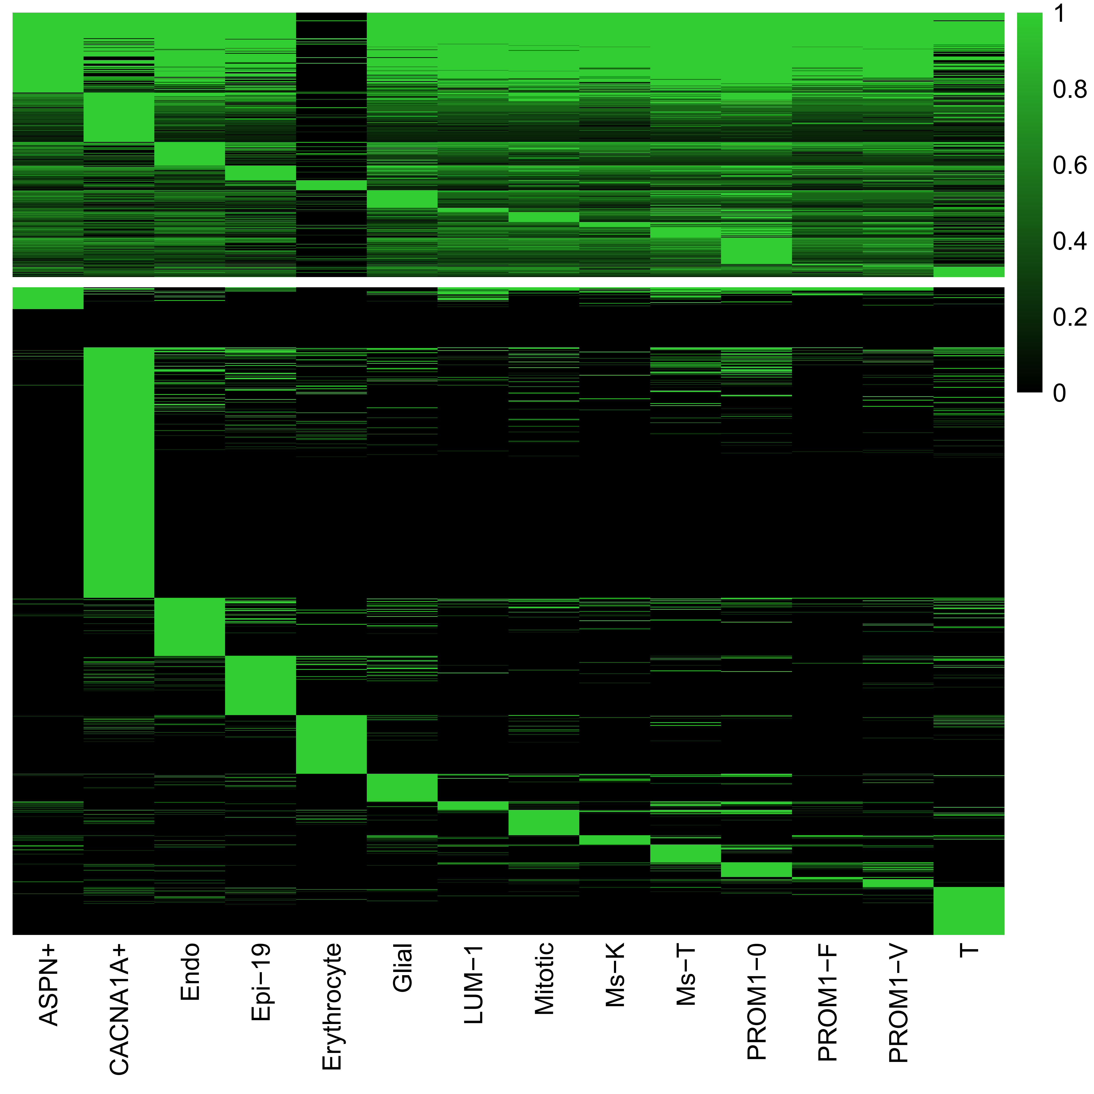
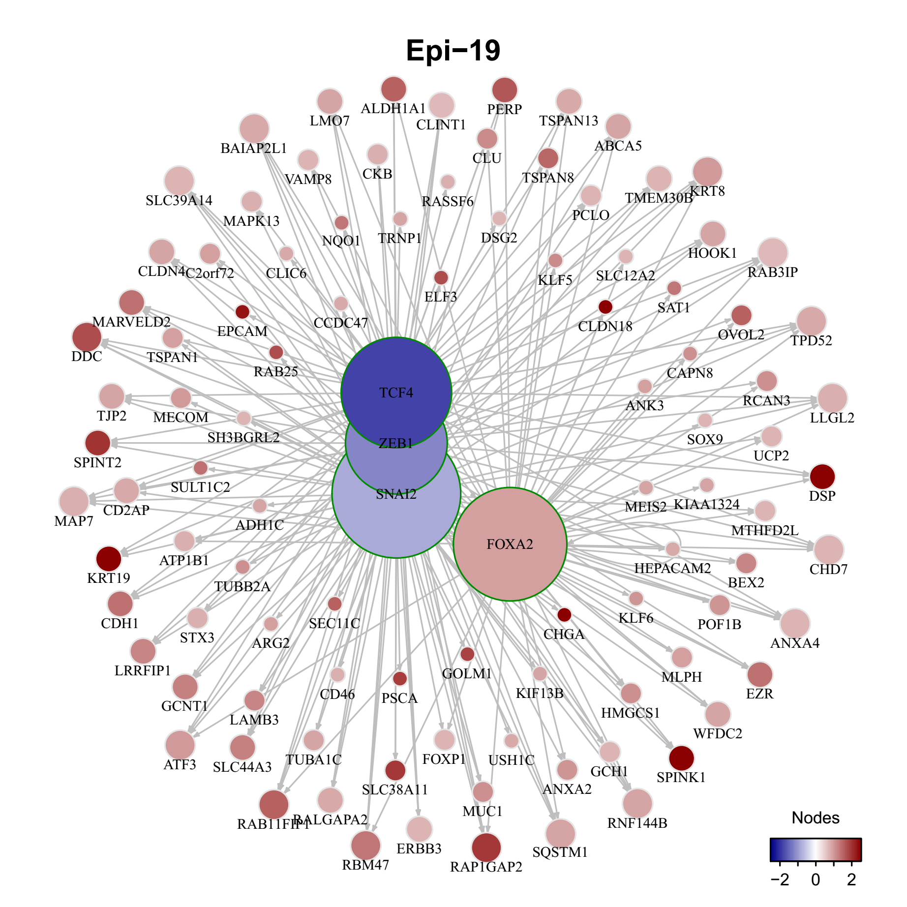
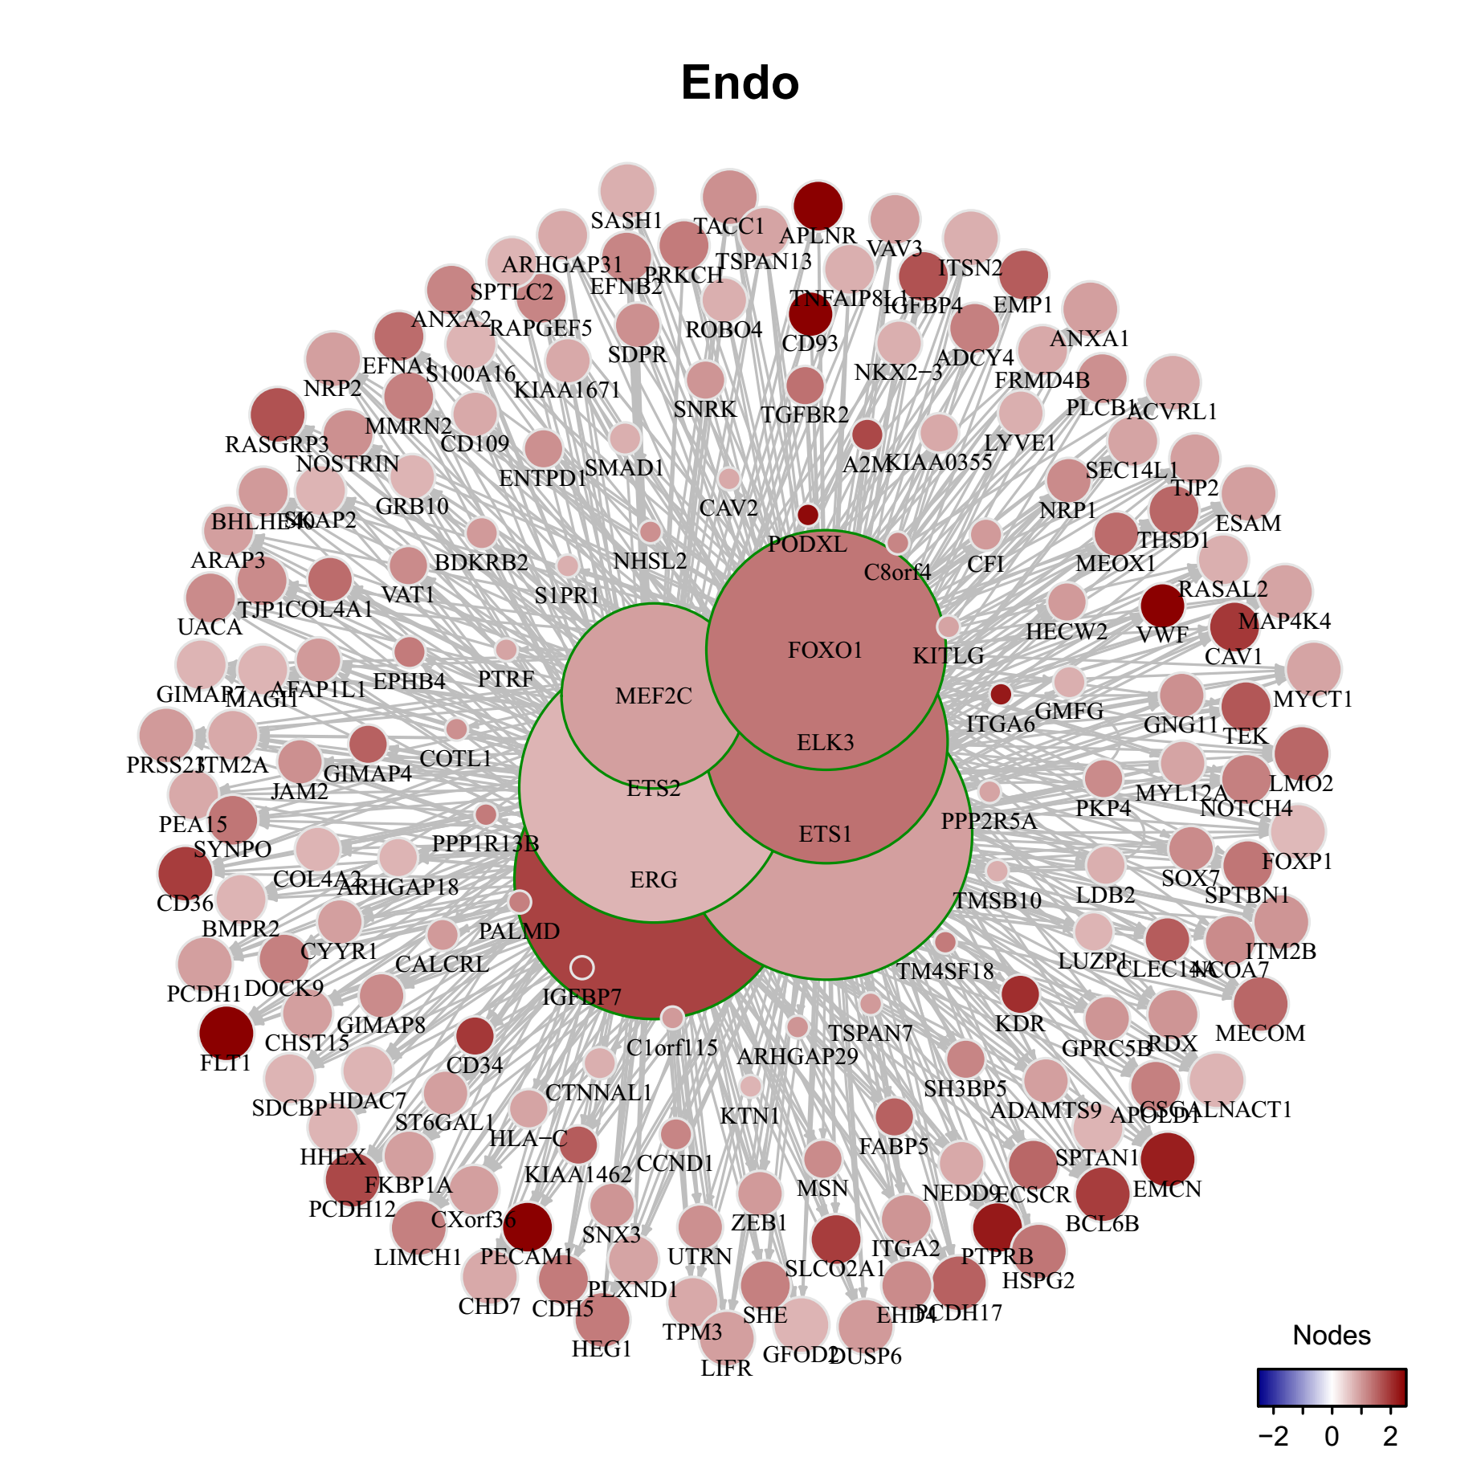
Part3: Transcriptional regulation across cell-types
A
B
Evolutionary ages / families for each type of TFs
C
D
Notes:
module gene ctype cellNum
ASPN+ 178 4113 ASPN+ 142
CACNA1A+ 265 5054 CACNA1A+ 88
Endo 235 5968 Endo 89
Epi-19 364 8822 Epi-19 63
Erythrocyte 98 9018 Erythrocyte 15
Glial 312 6514 Glial 66
LUM-1 120 2033 LUM-1 485
Mitotic 197 4038 Mitotic 177
Ms-K 187 3763 Ms-K 184
Ms-T 198 3840 Ms-T 187
PROM1-0 41 643 PROM1-0 991
PROM1-F 138 2299 PROM1-F 344
PROM1-V 191 4116 PROM1-V 140
T 231 5236 T 121

Slide 7
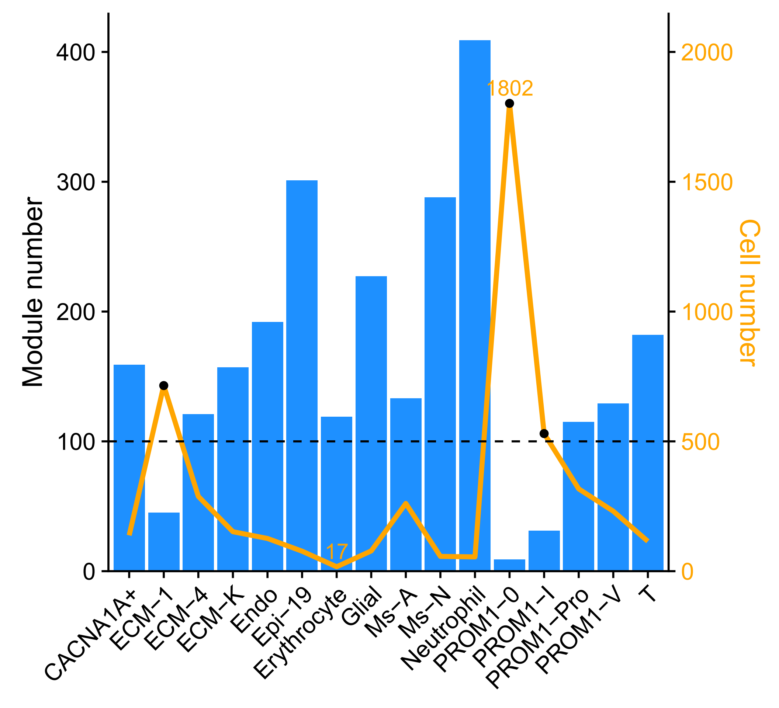
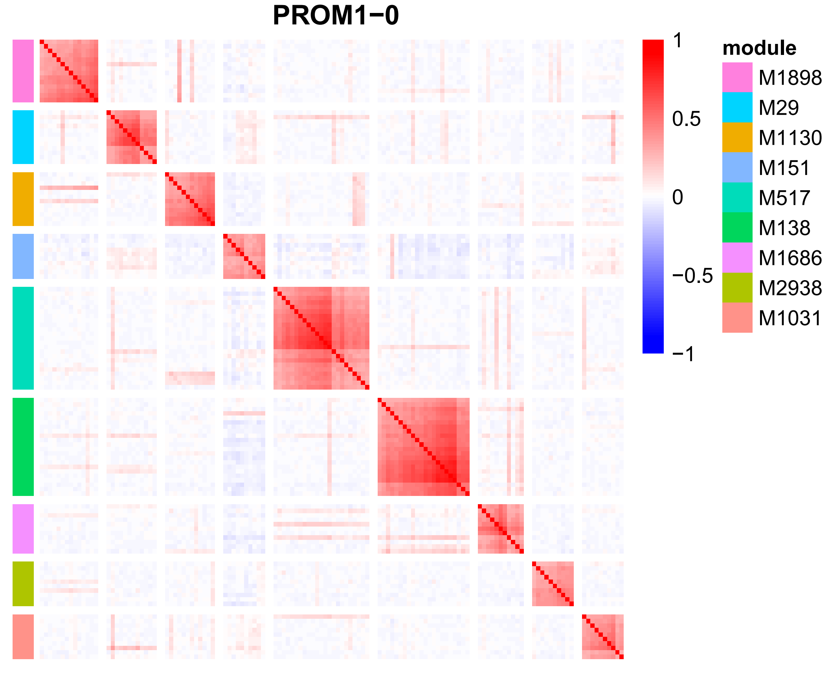
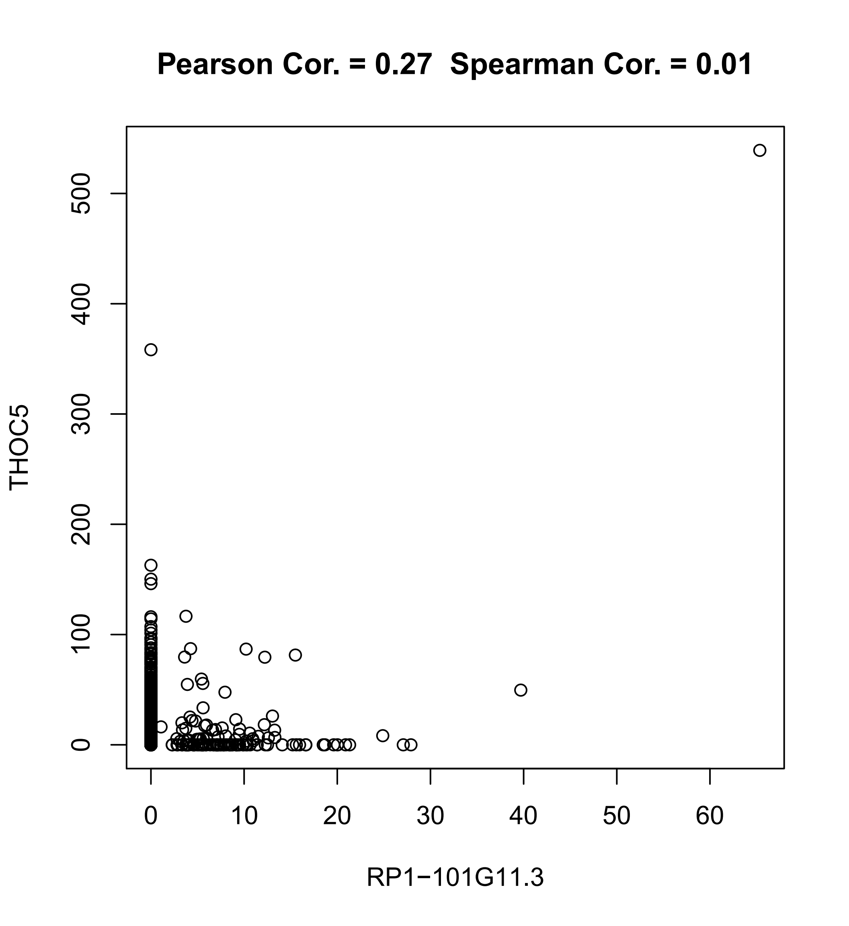
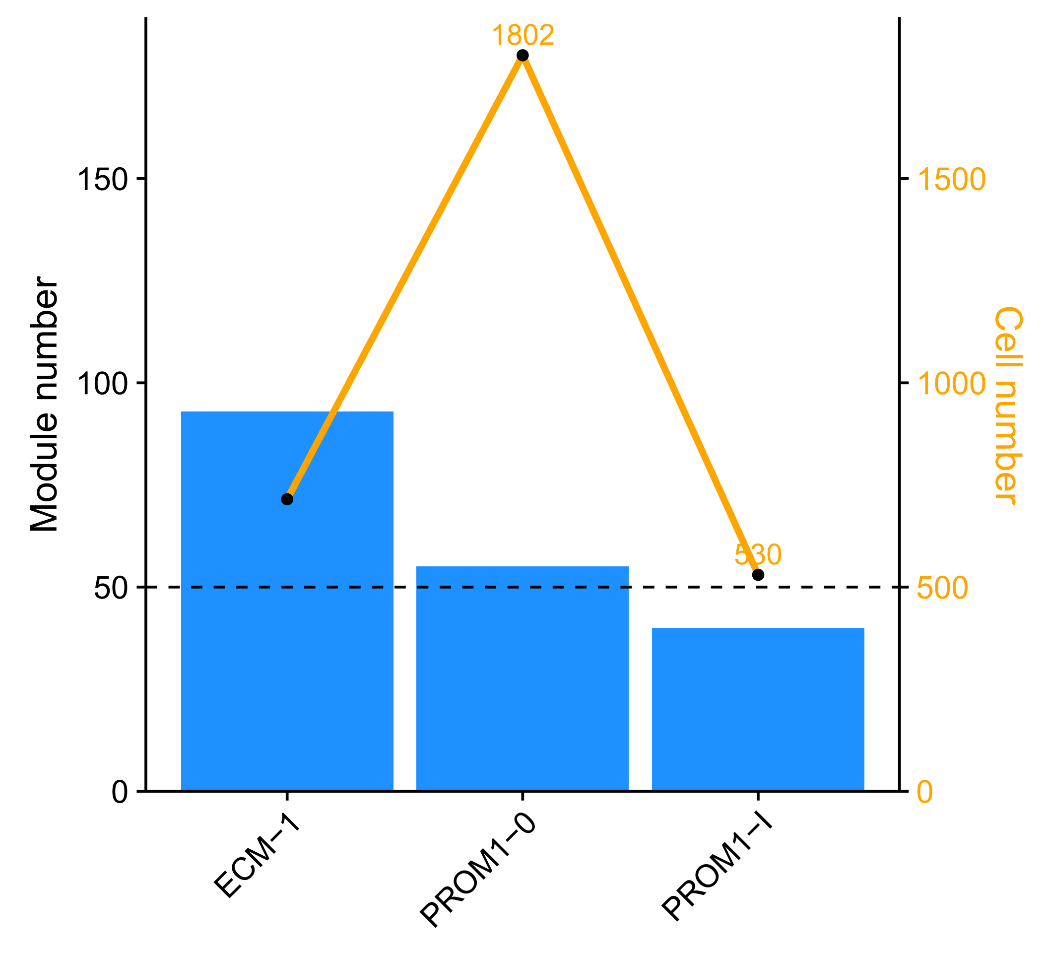
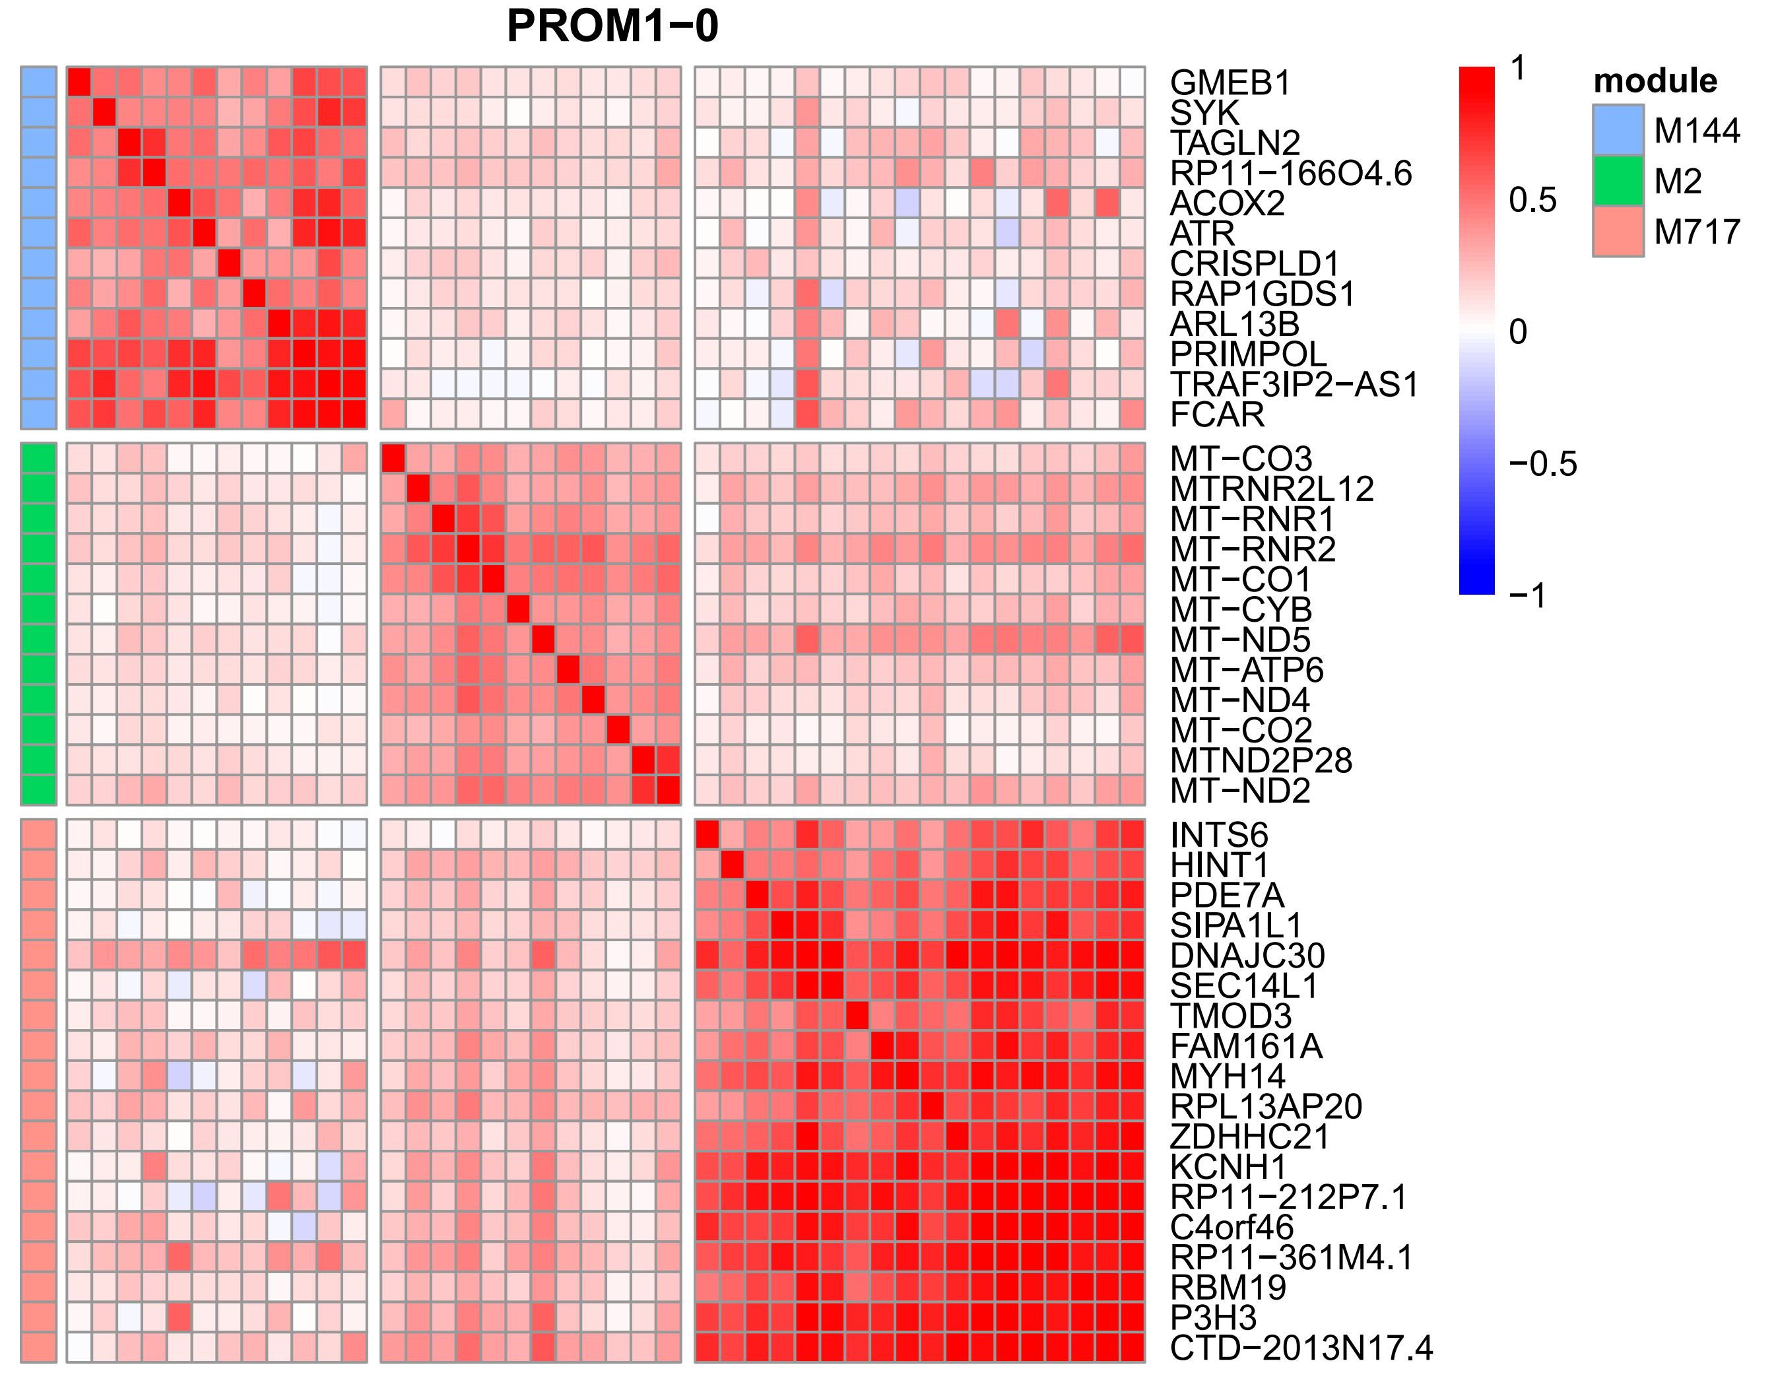
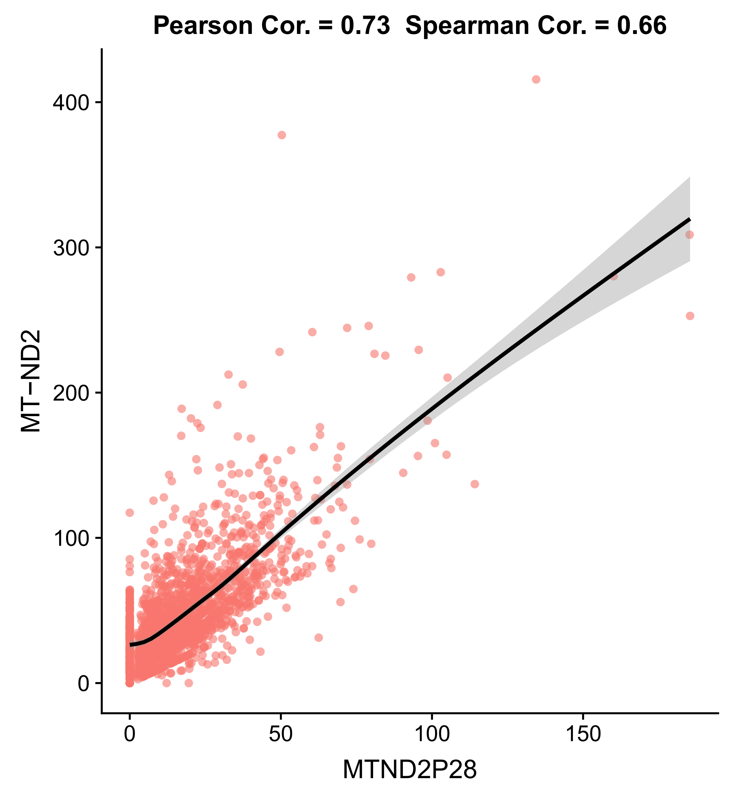
Part4: Co-expression modules within each cell type
A
B
C

Slide 8
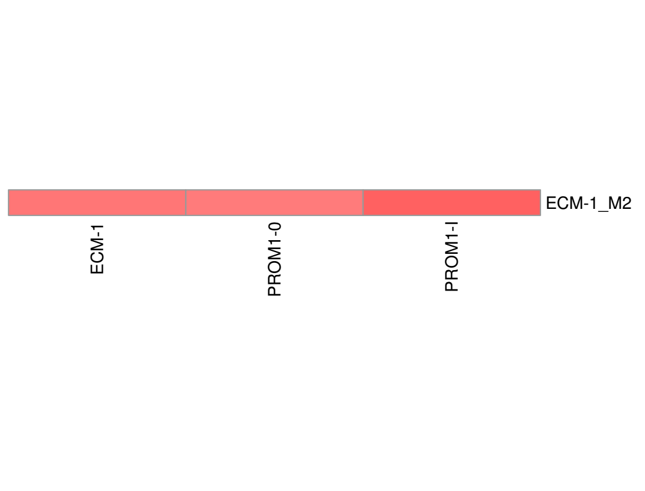
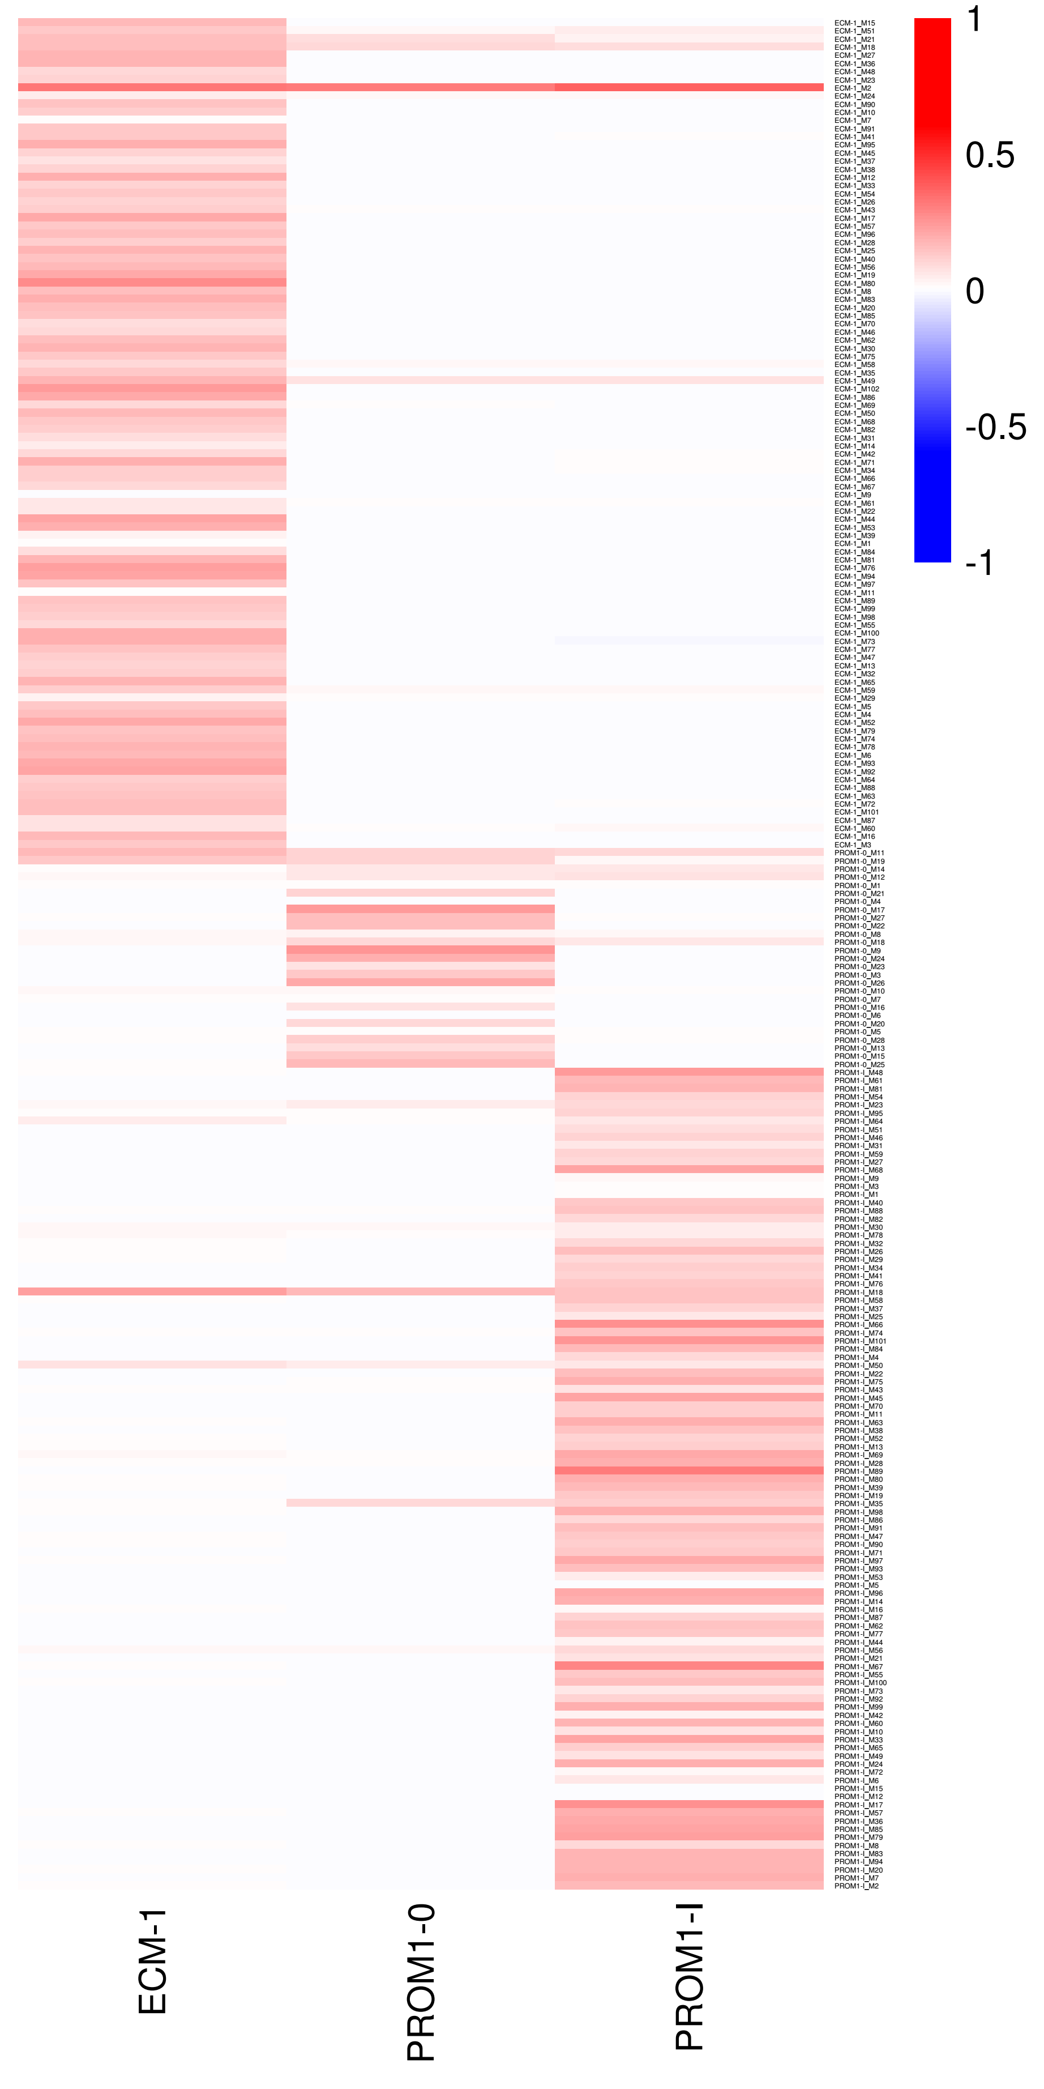
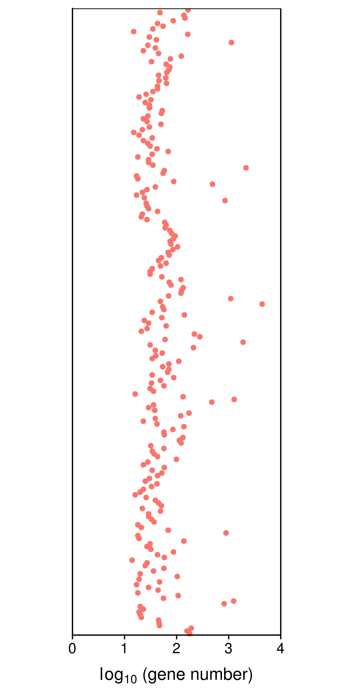
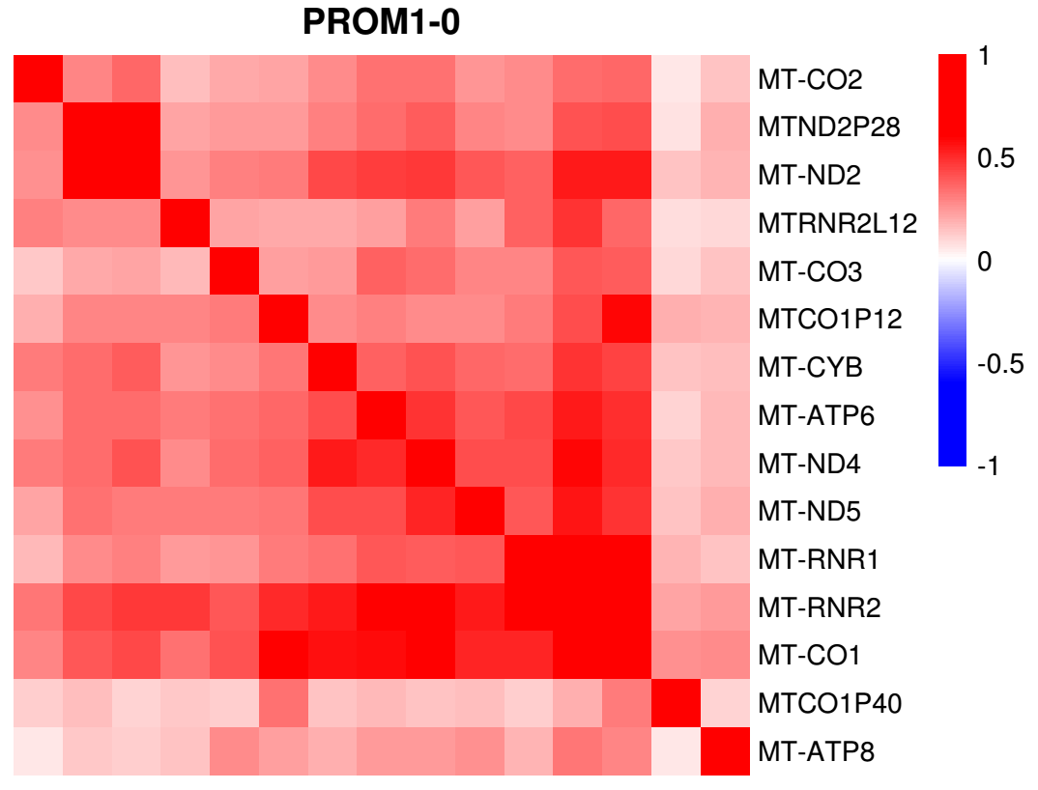
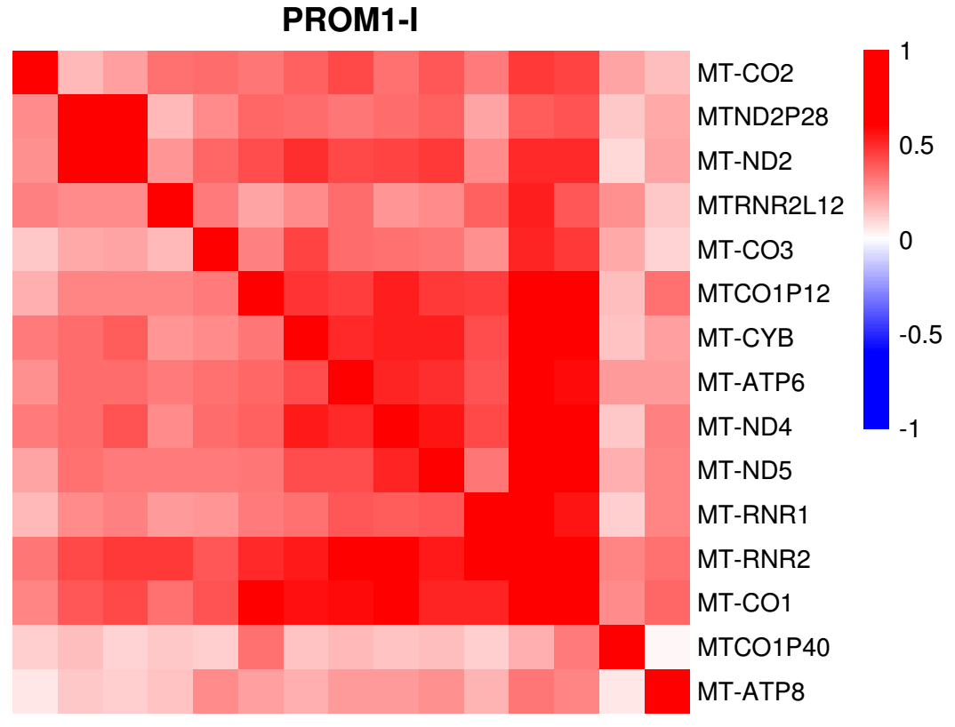
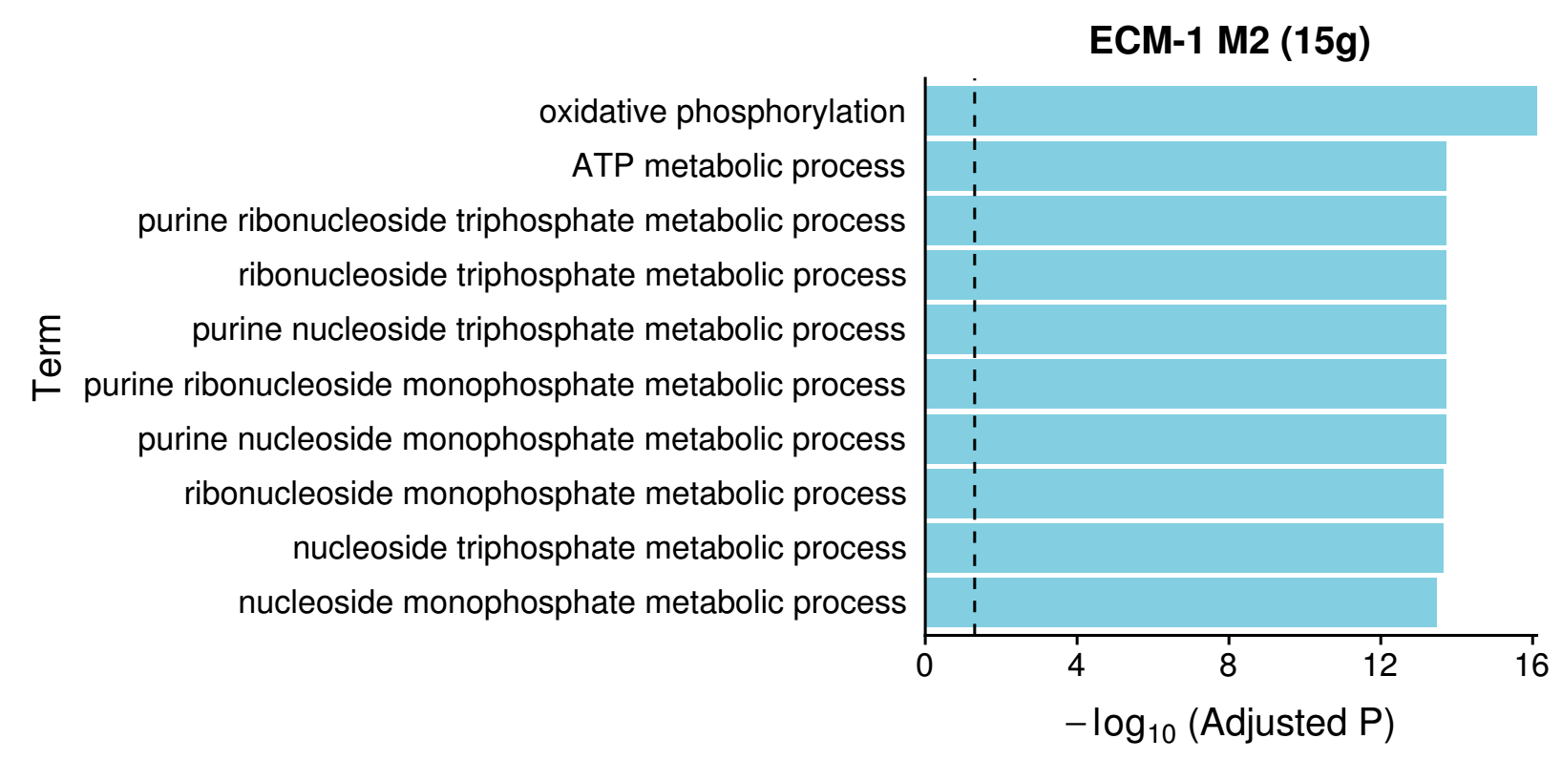
Module map
ECM-1
Notes:
230 modules

Slide 9
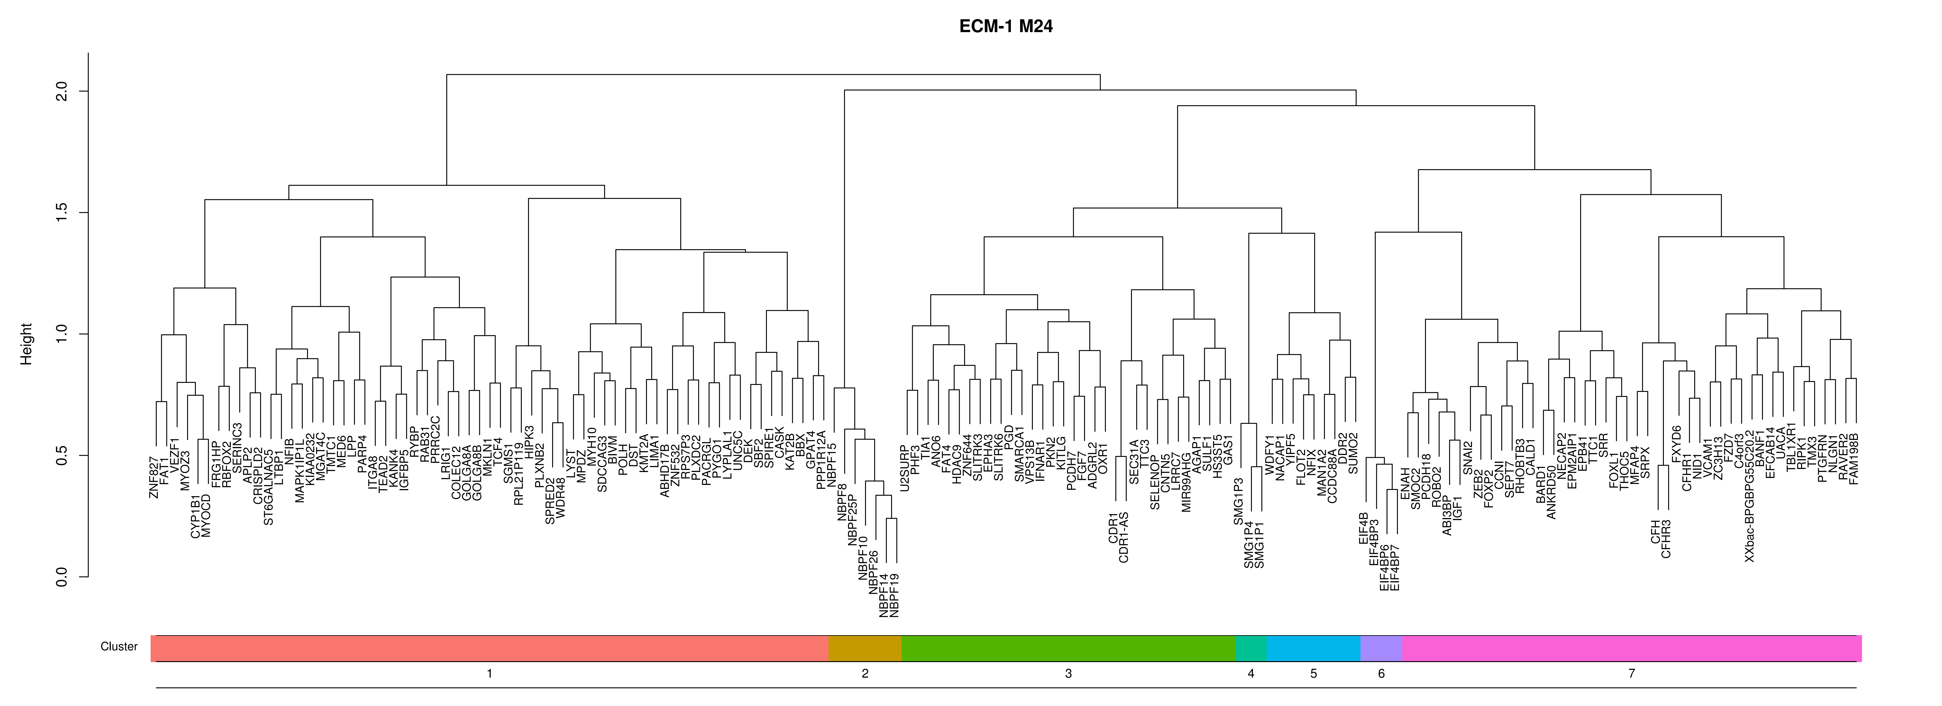
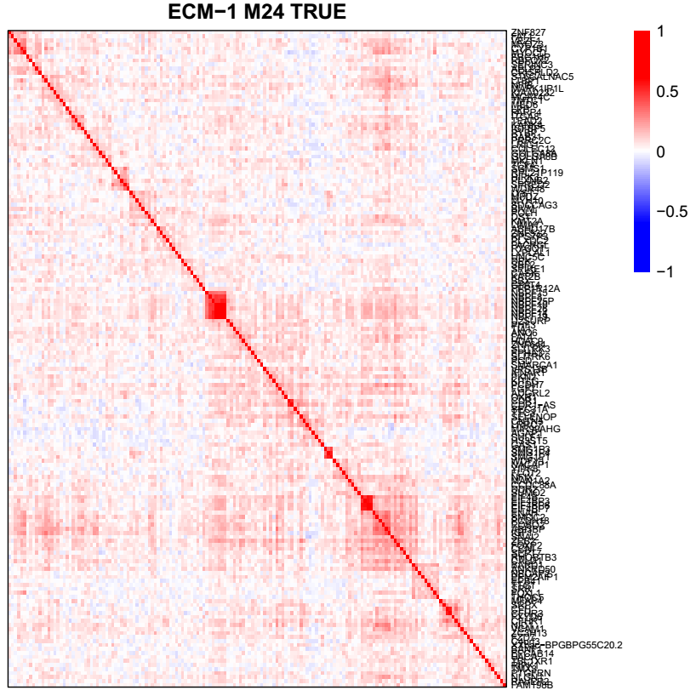
Refinement of gene modules
Extract genes with differential correlation

Slide 10
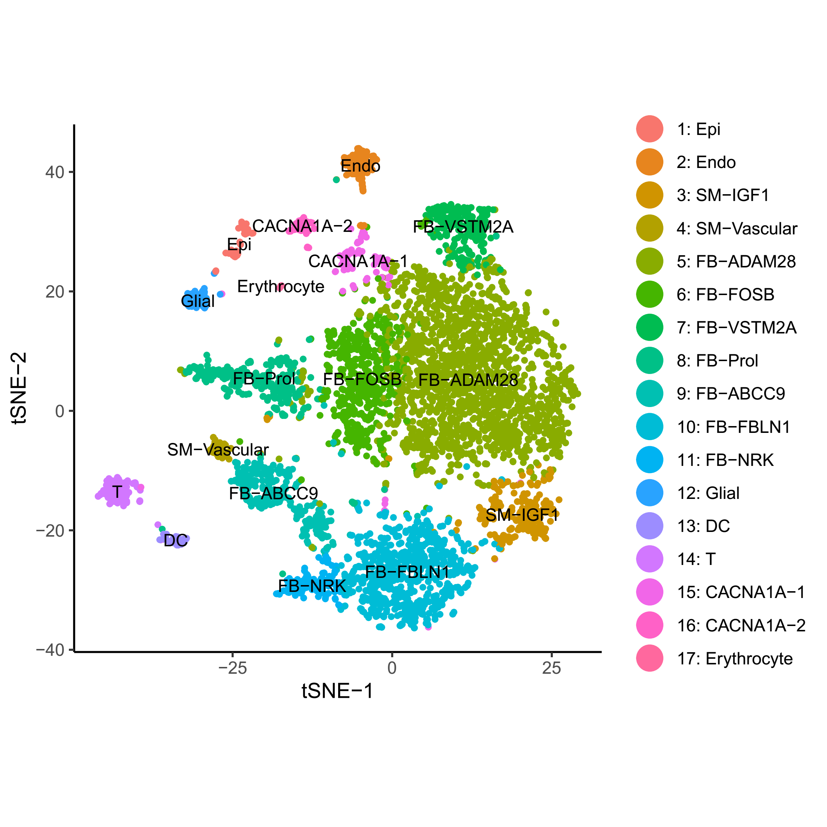
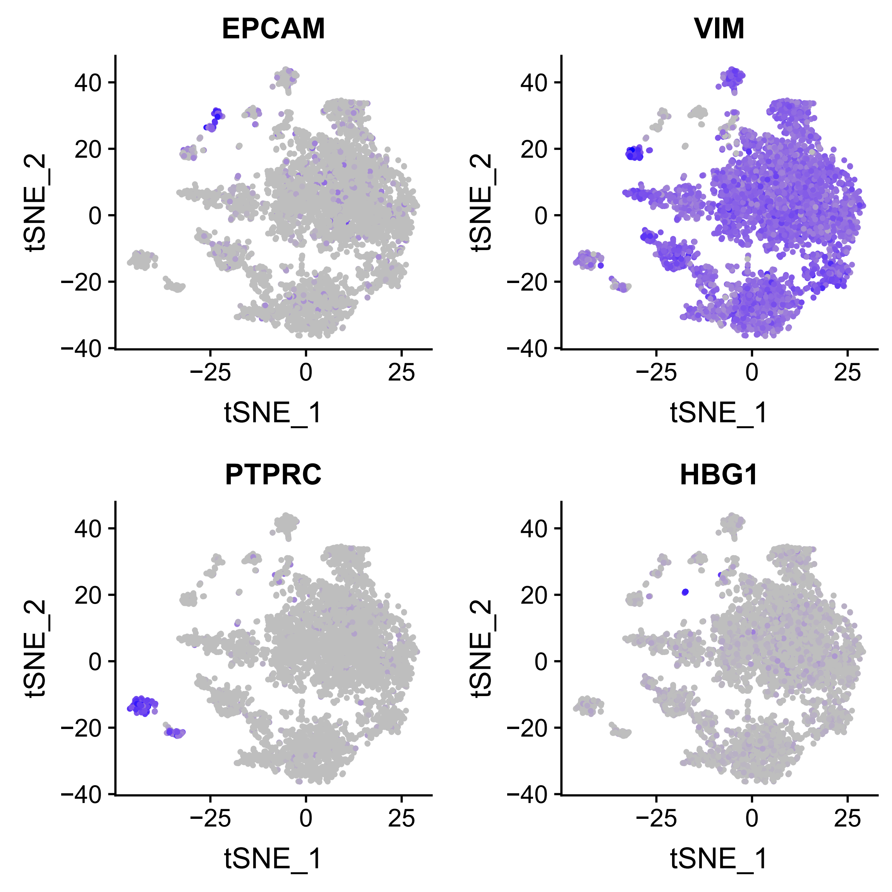
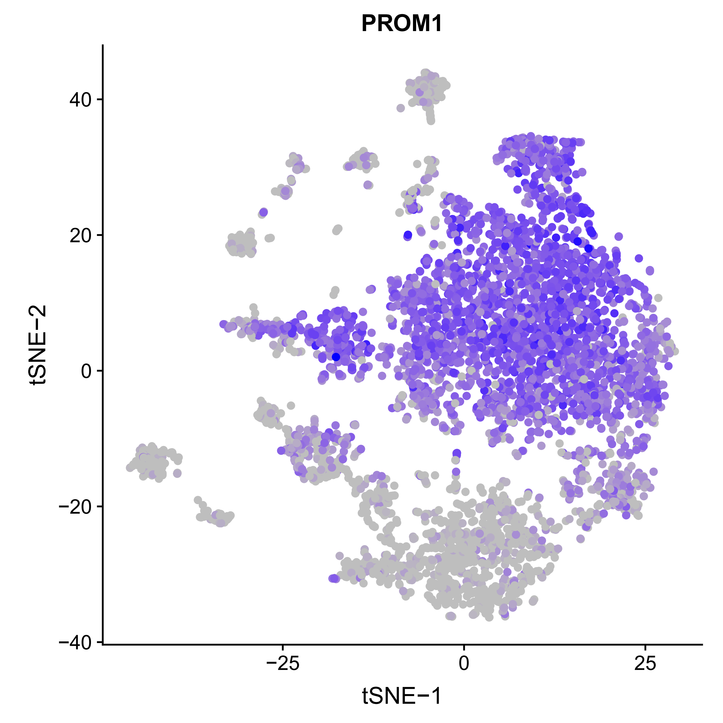
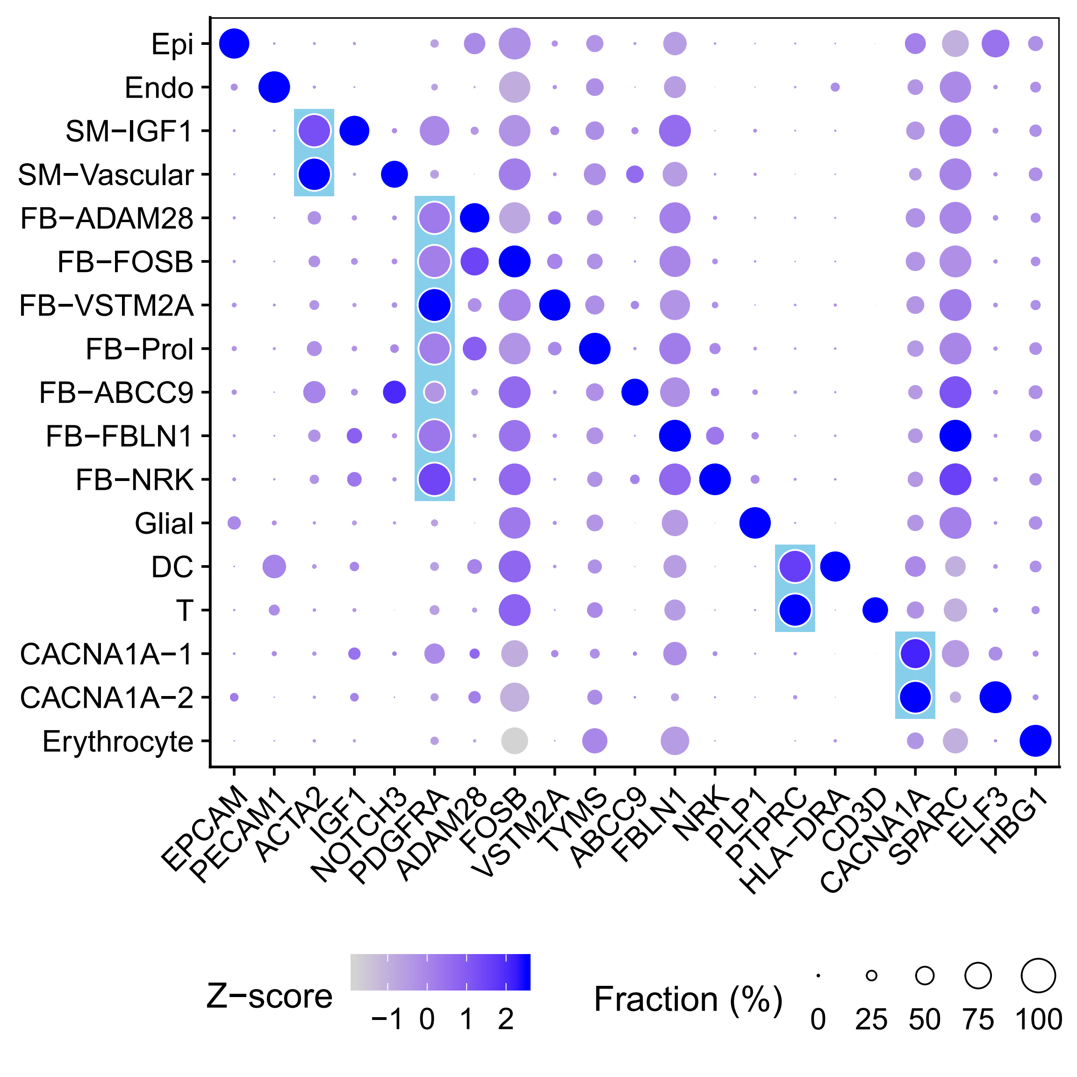
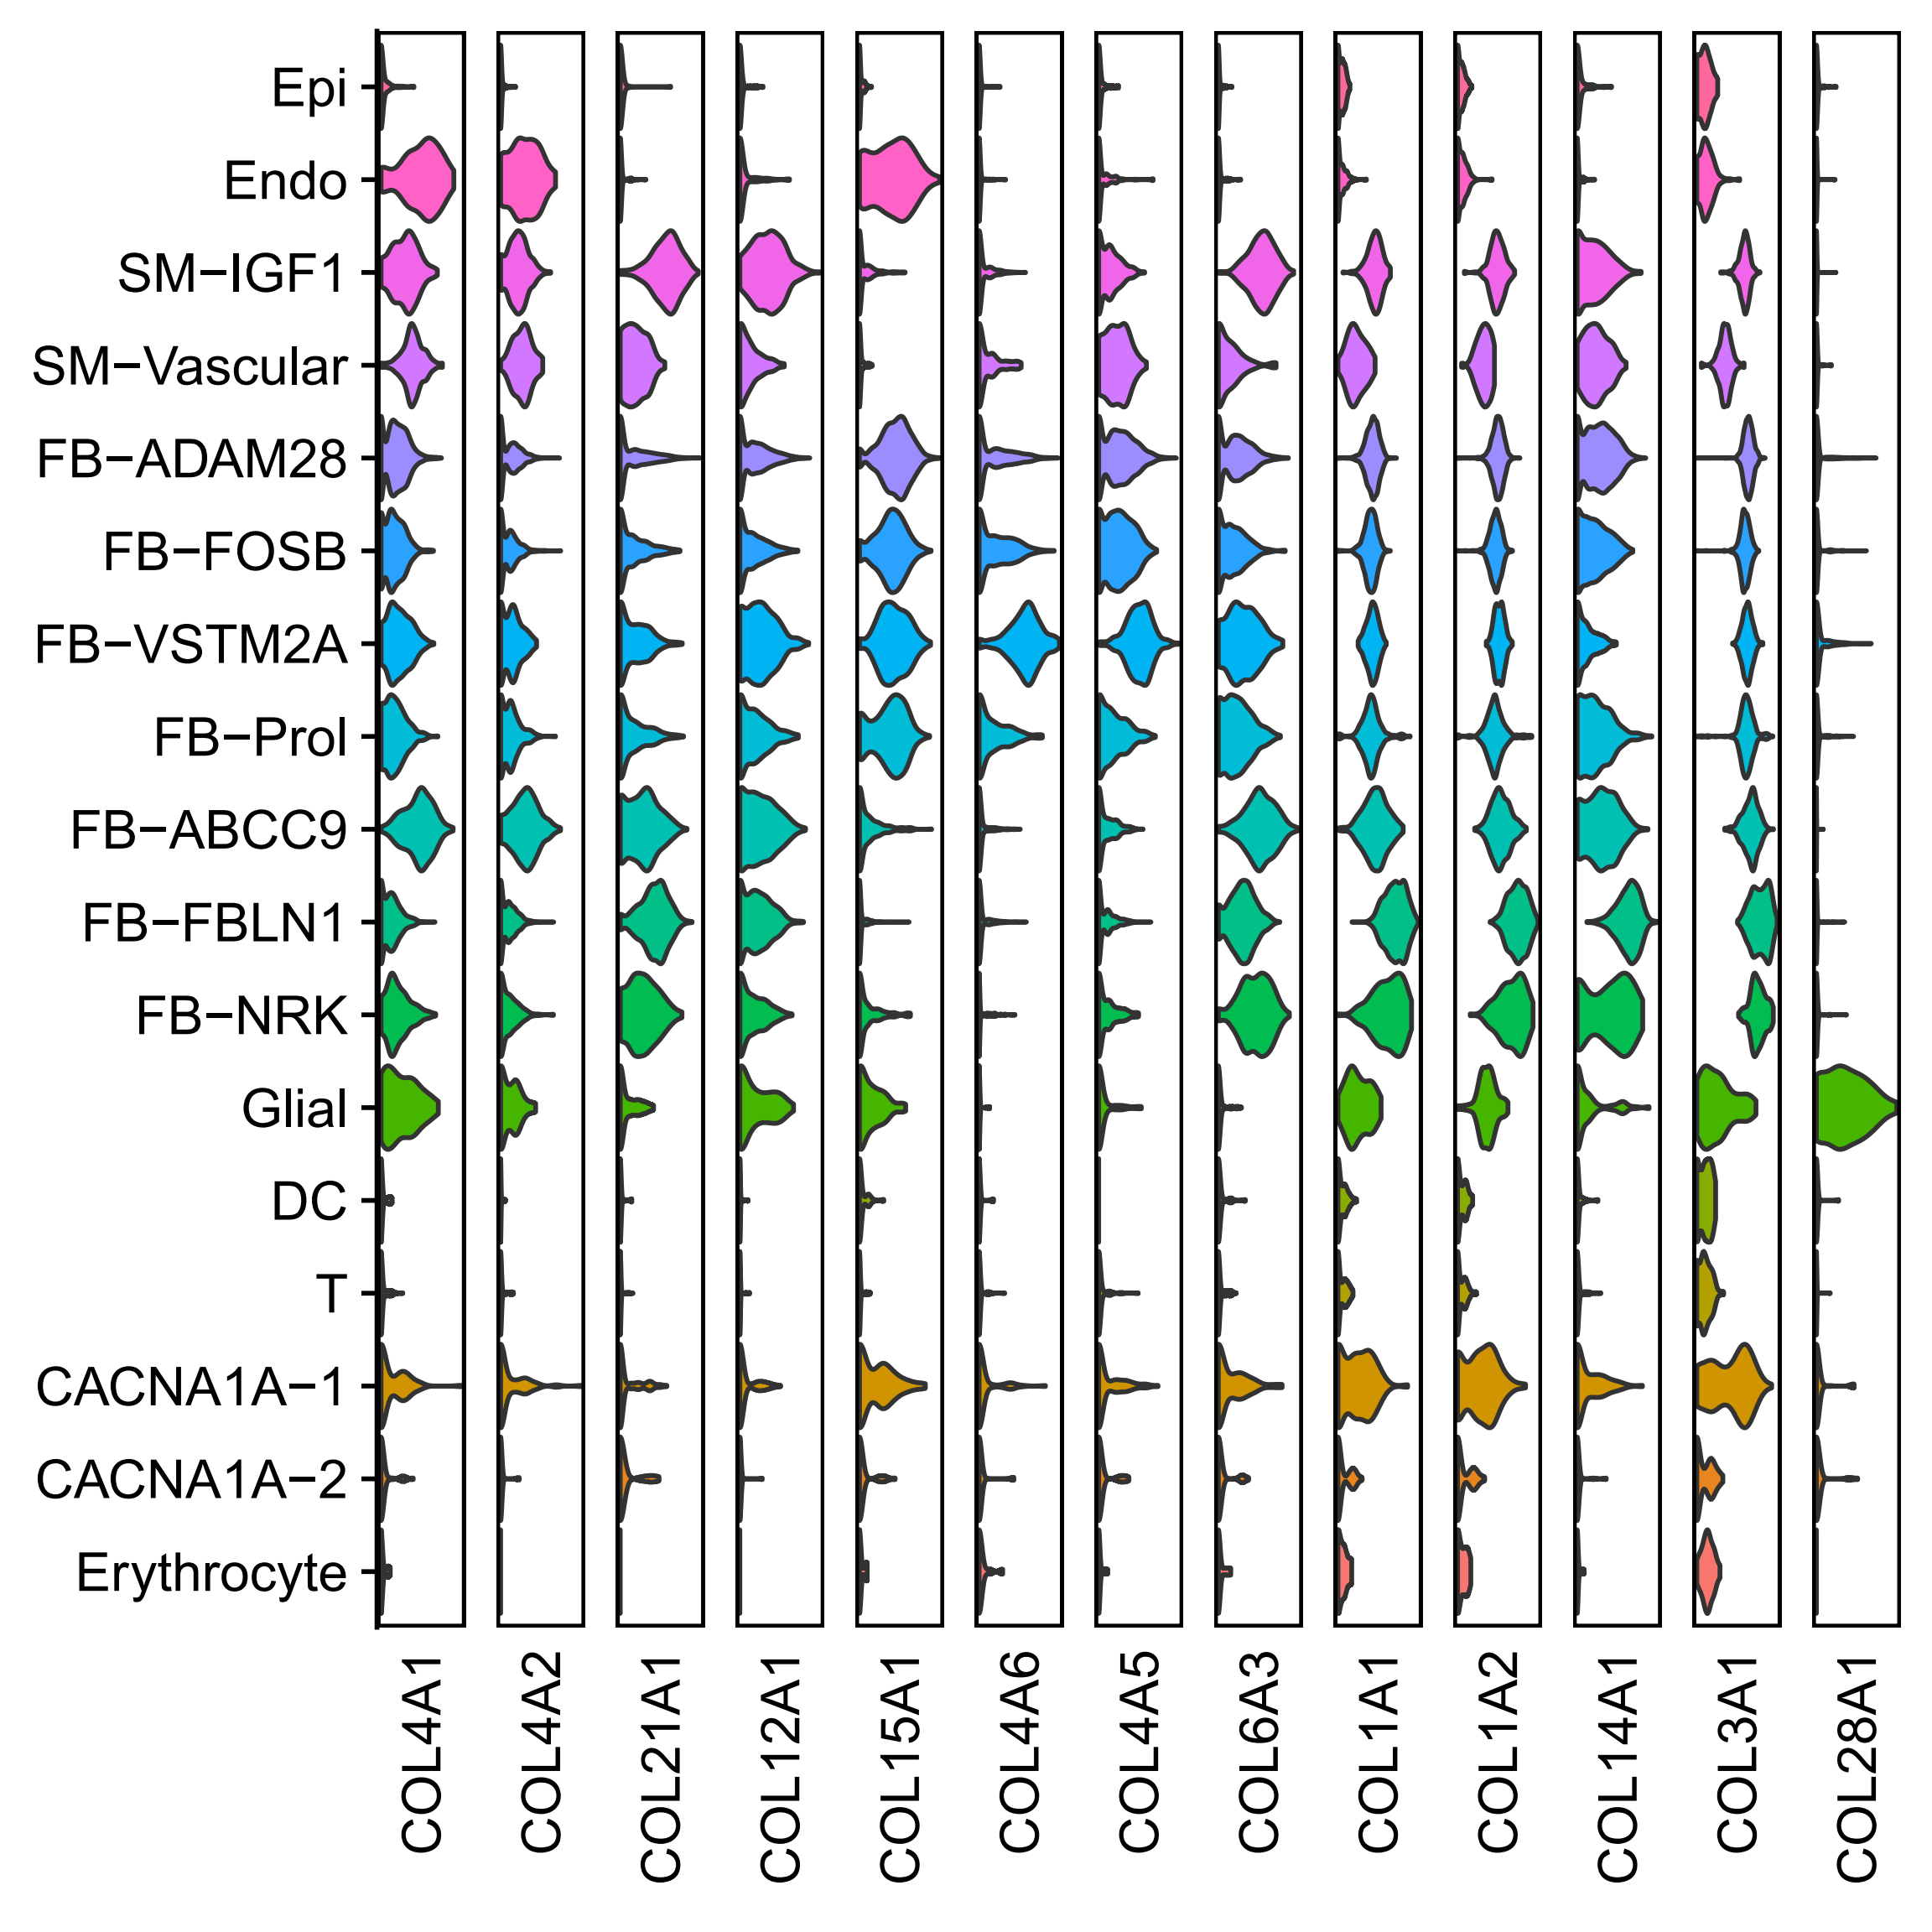
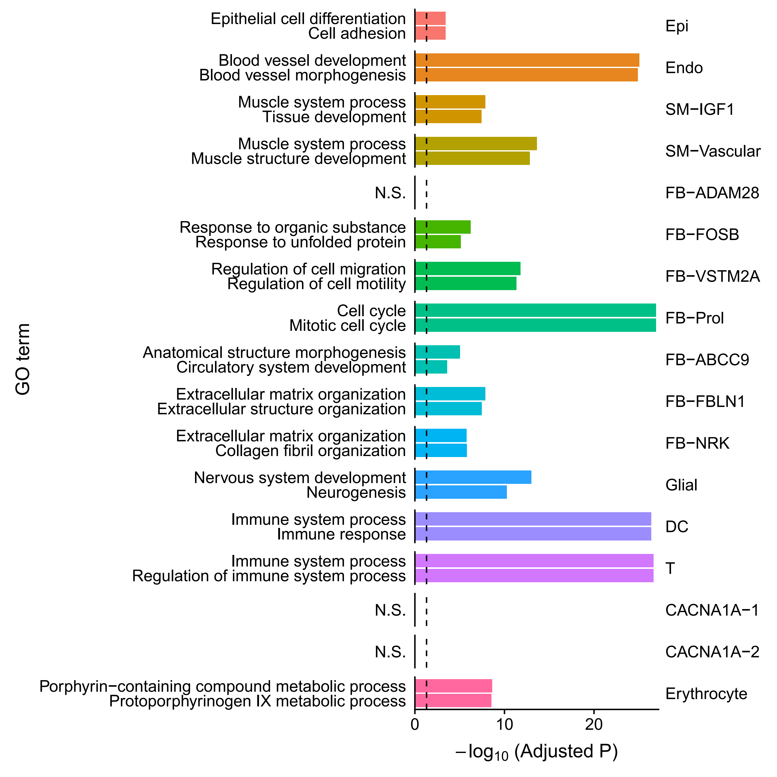
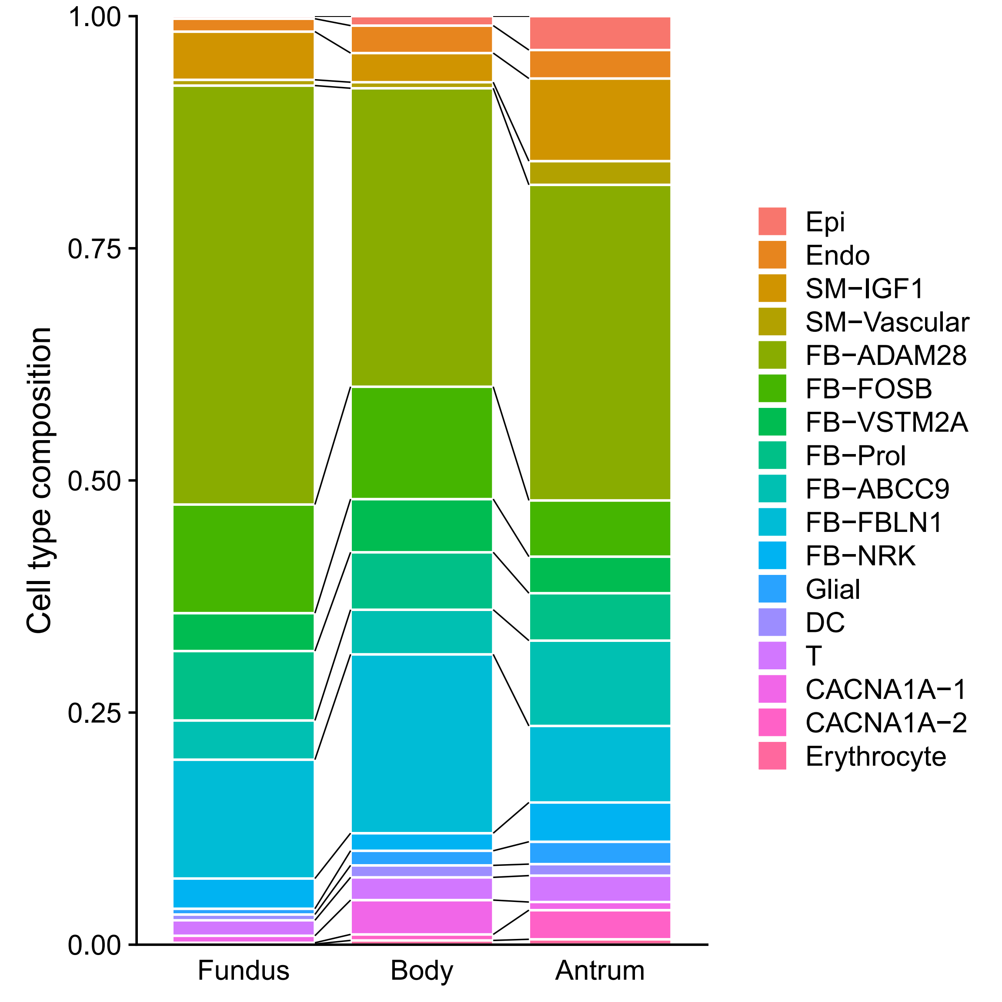
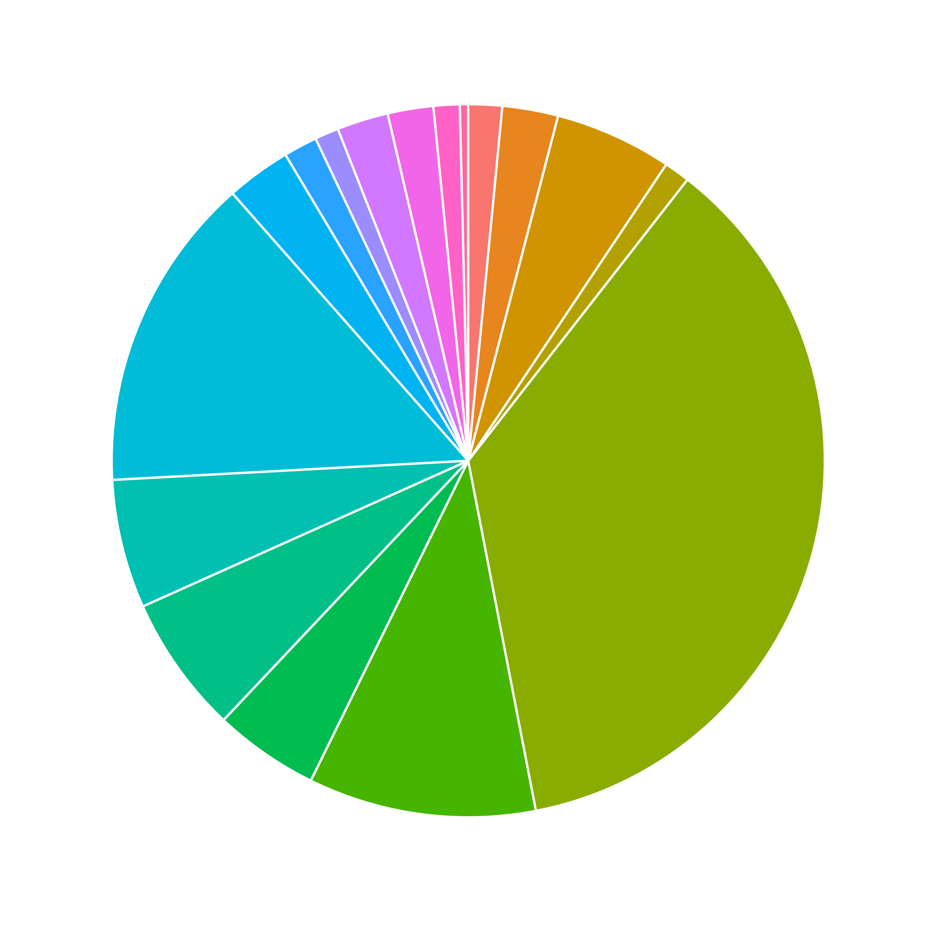
Stomach

Slide 11
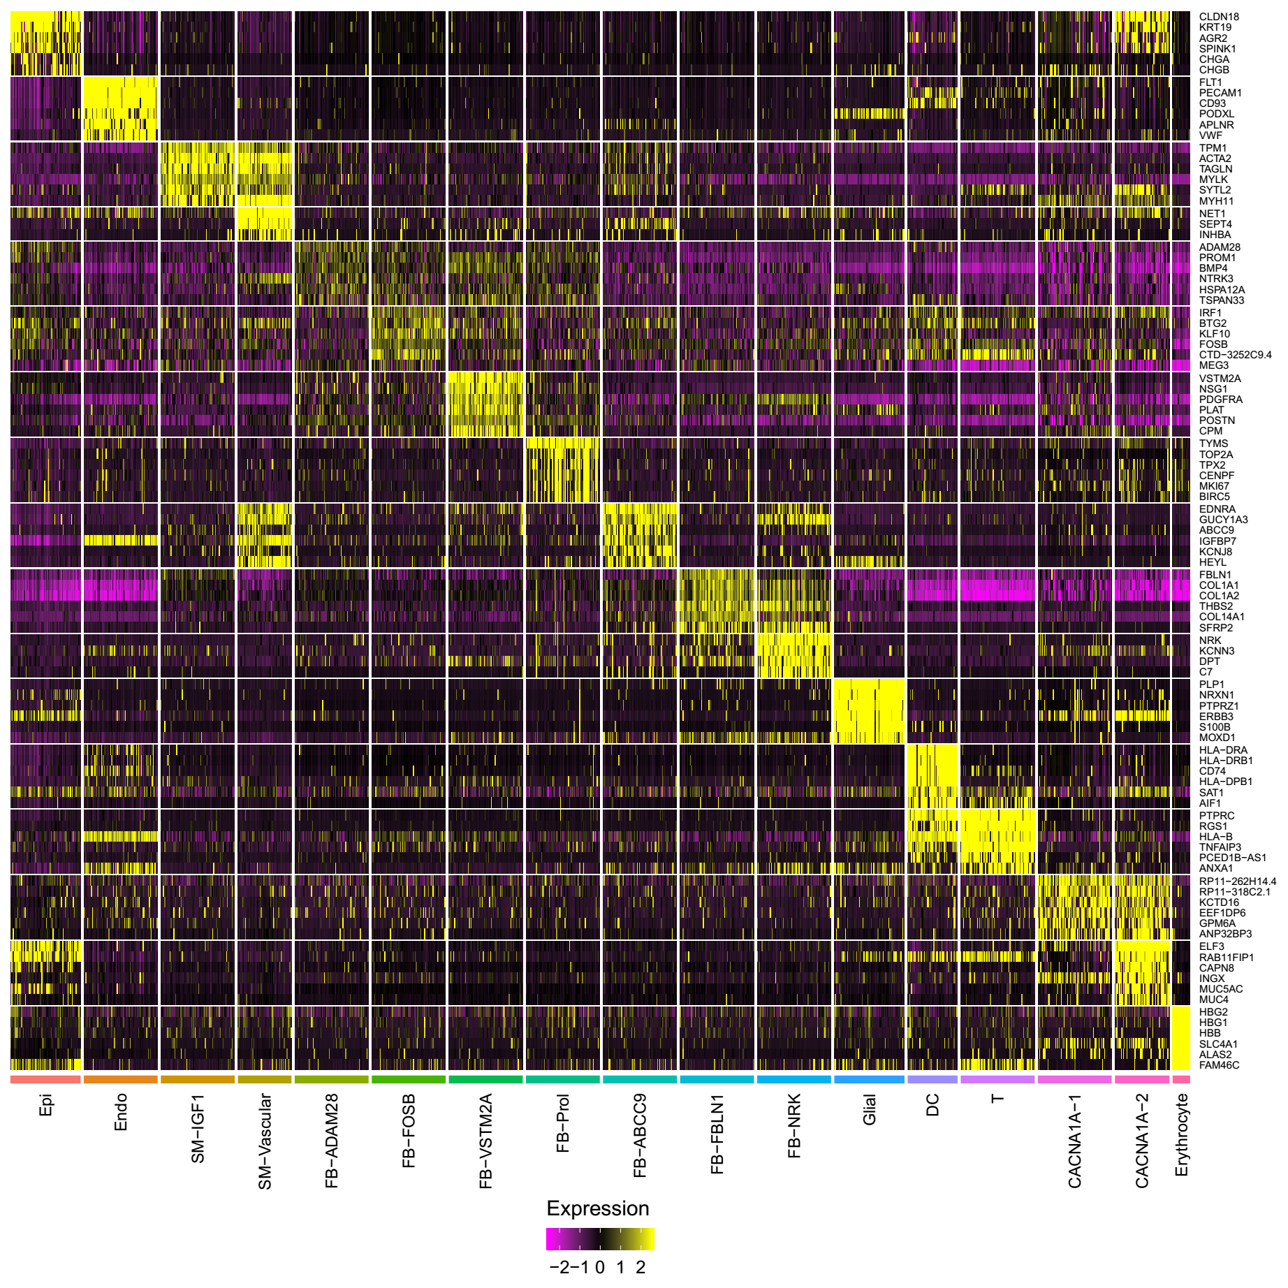
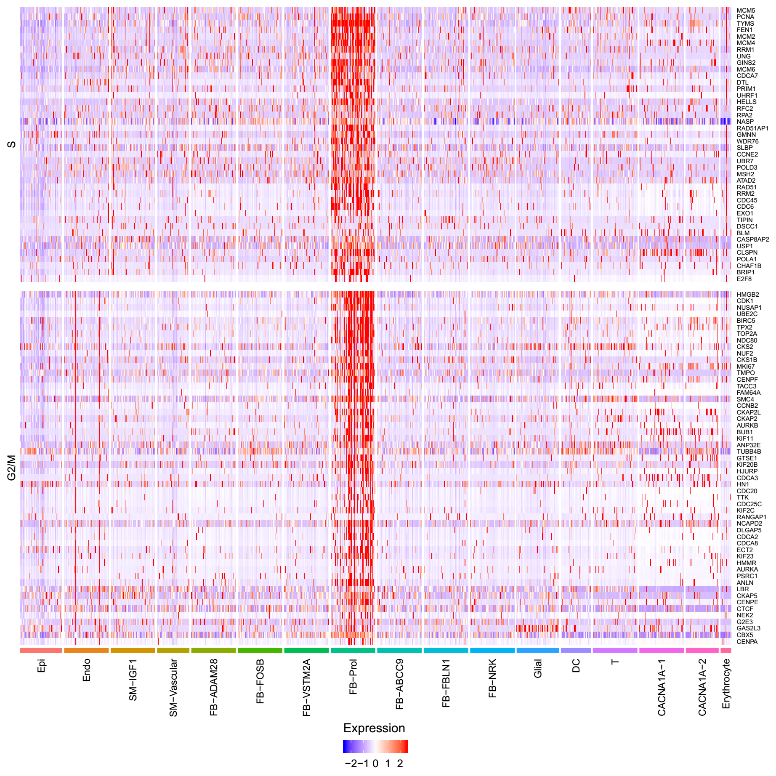
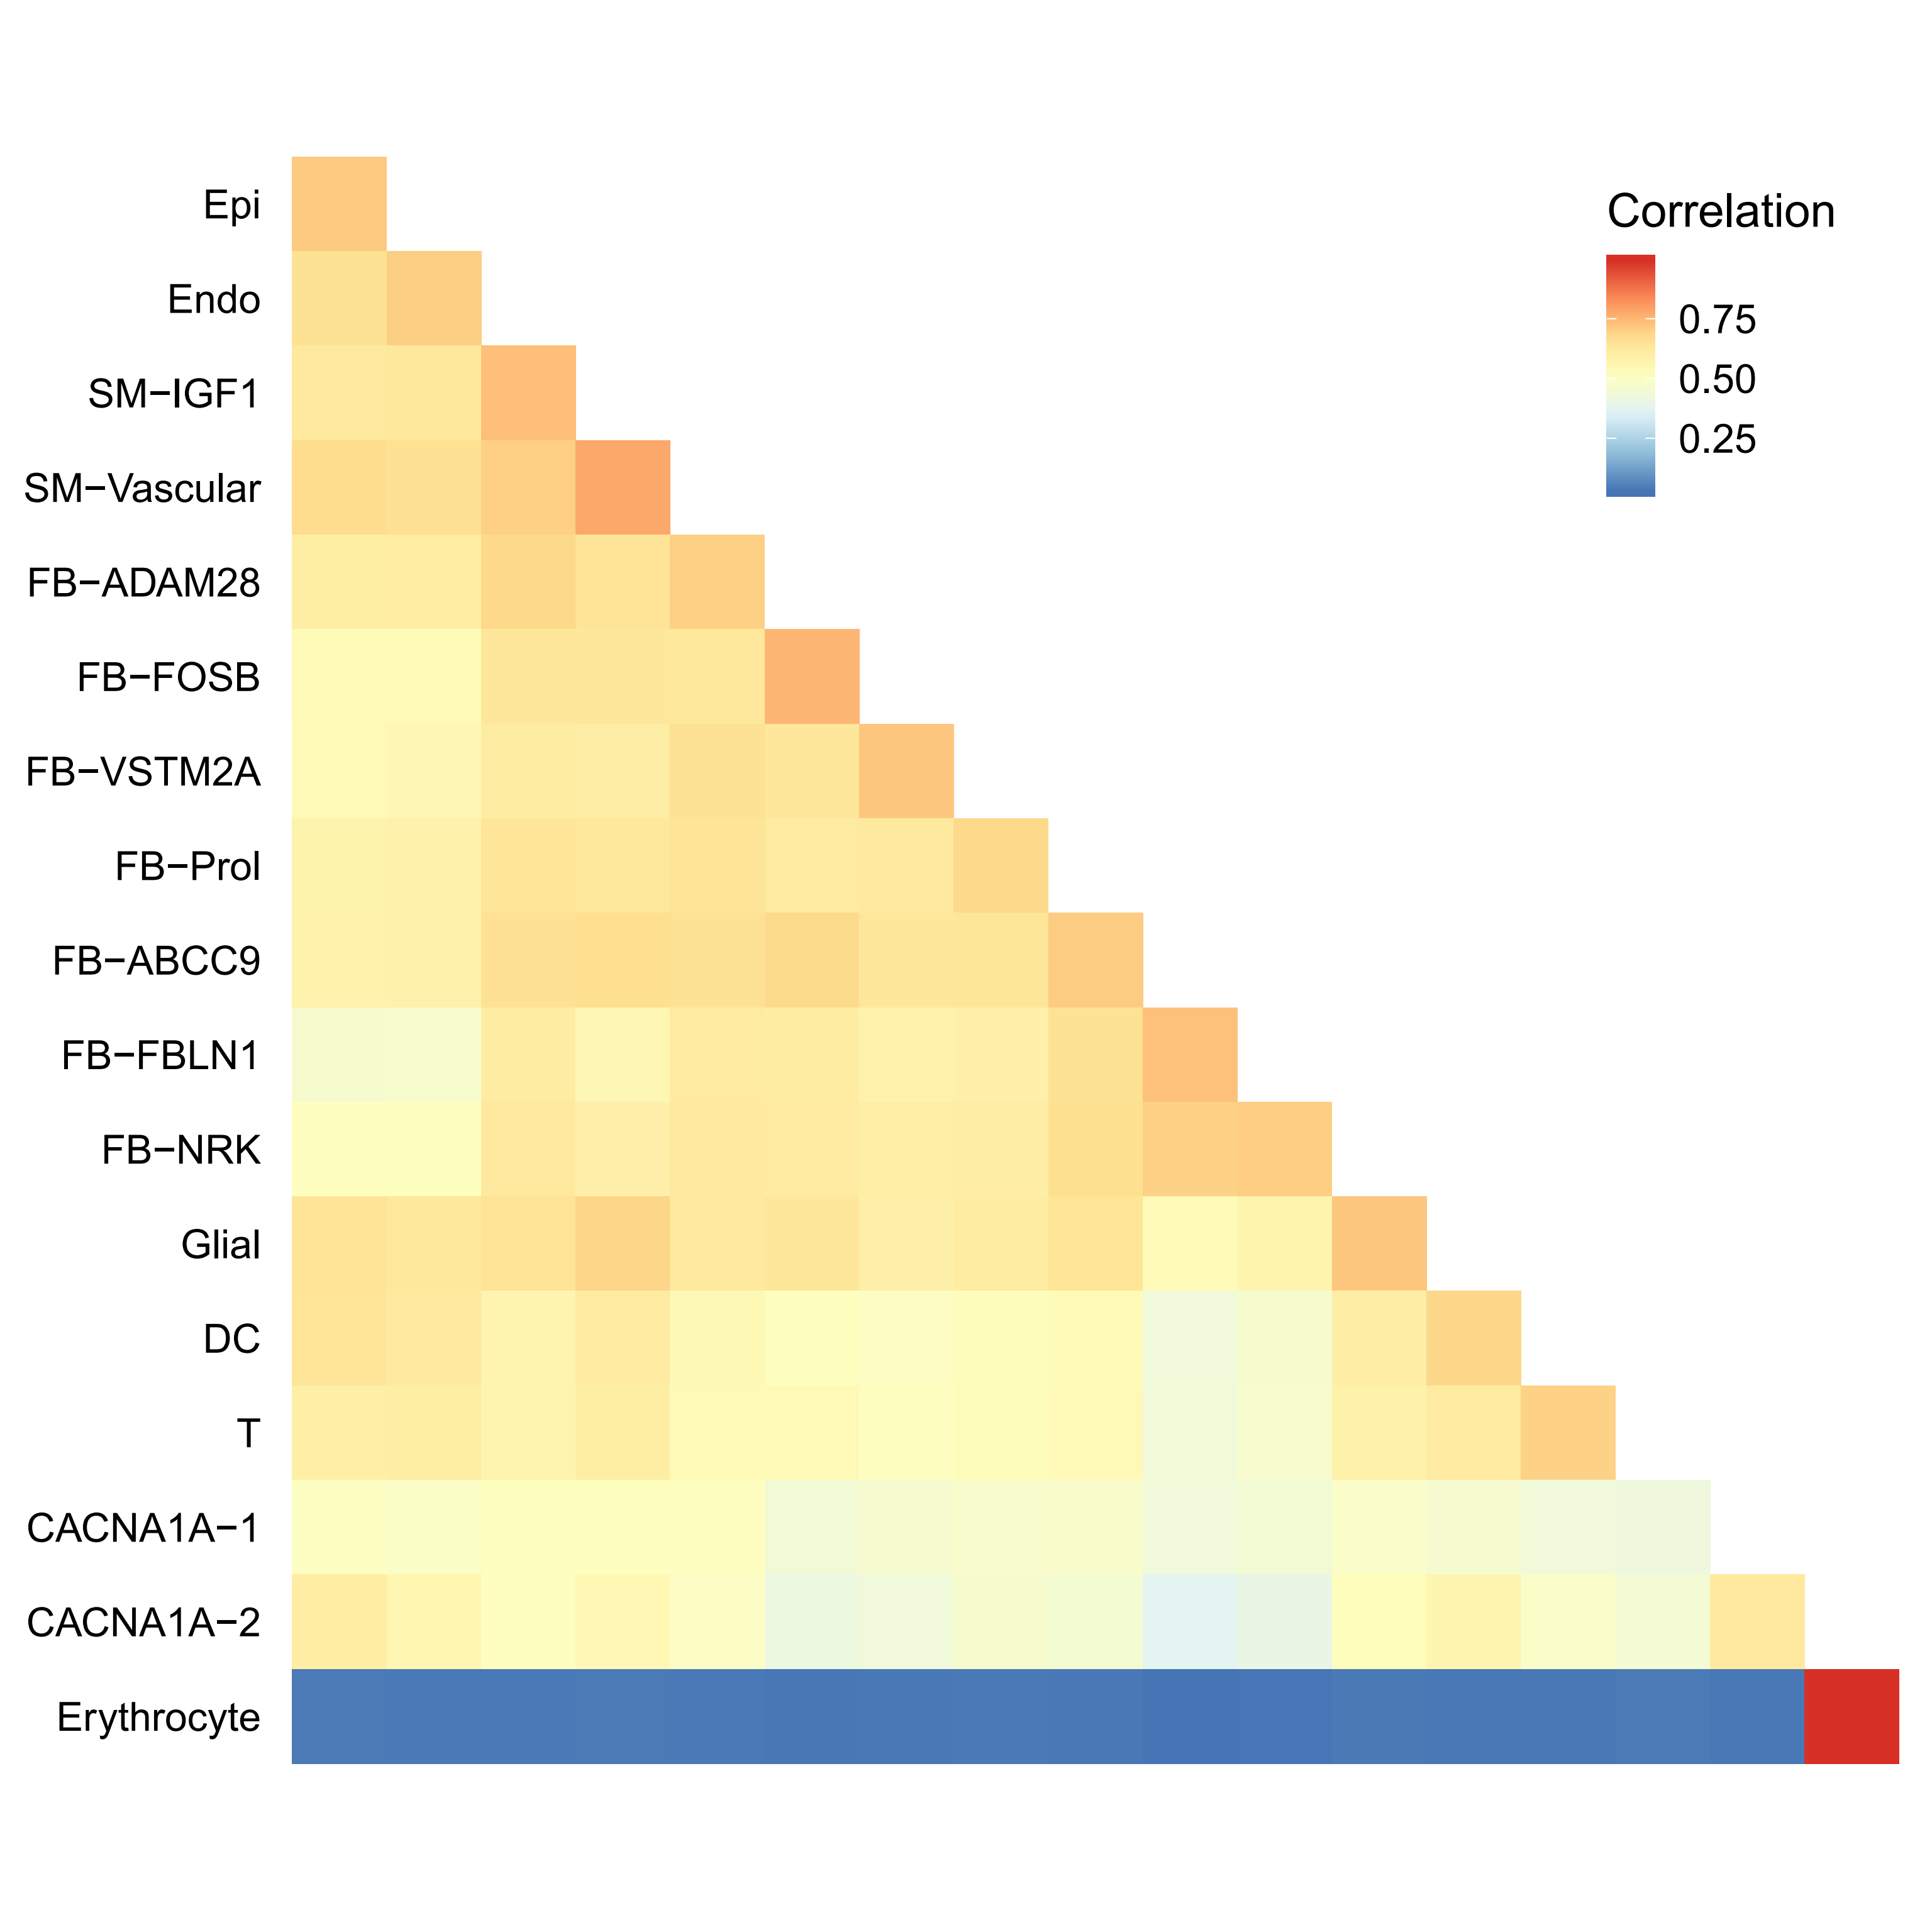
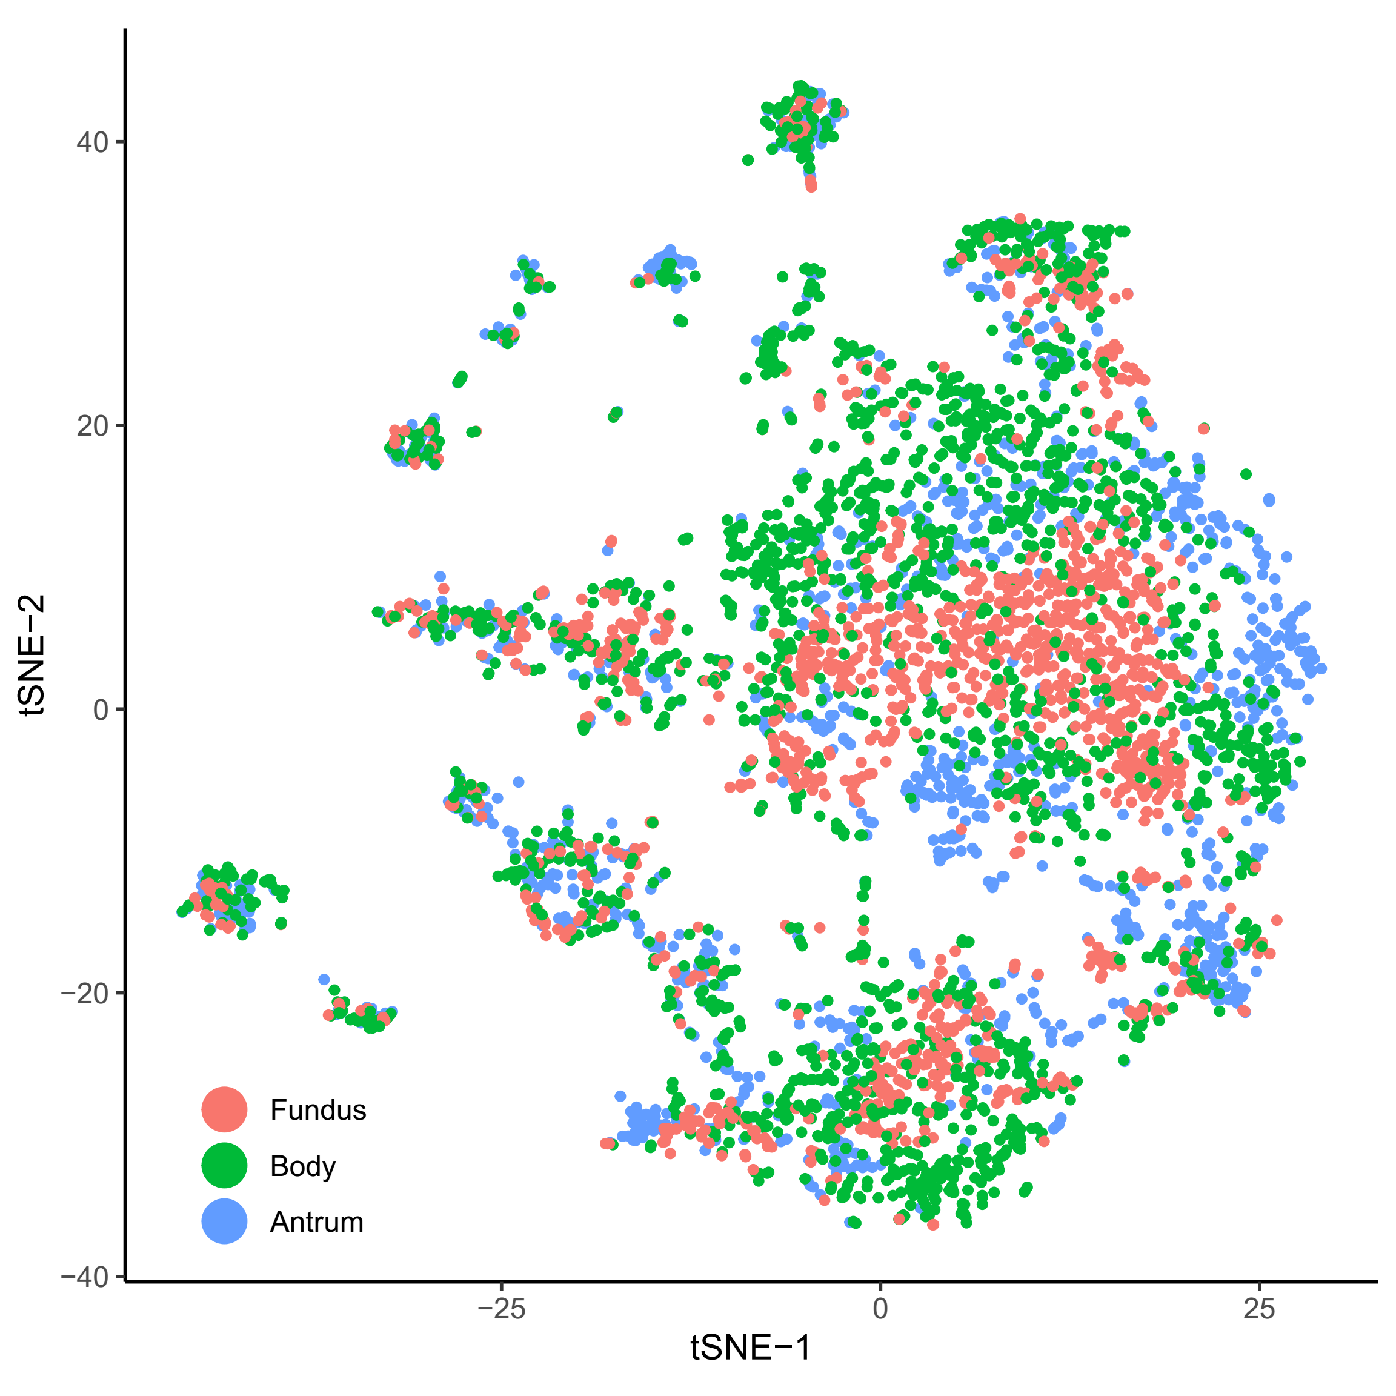
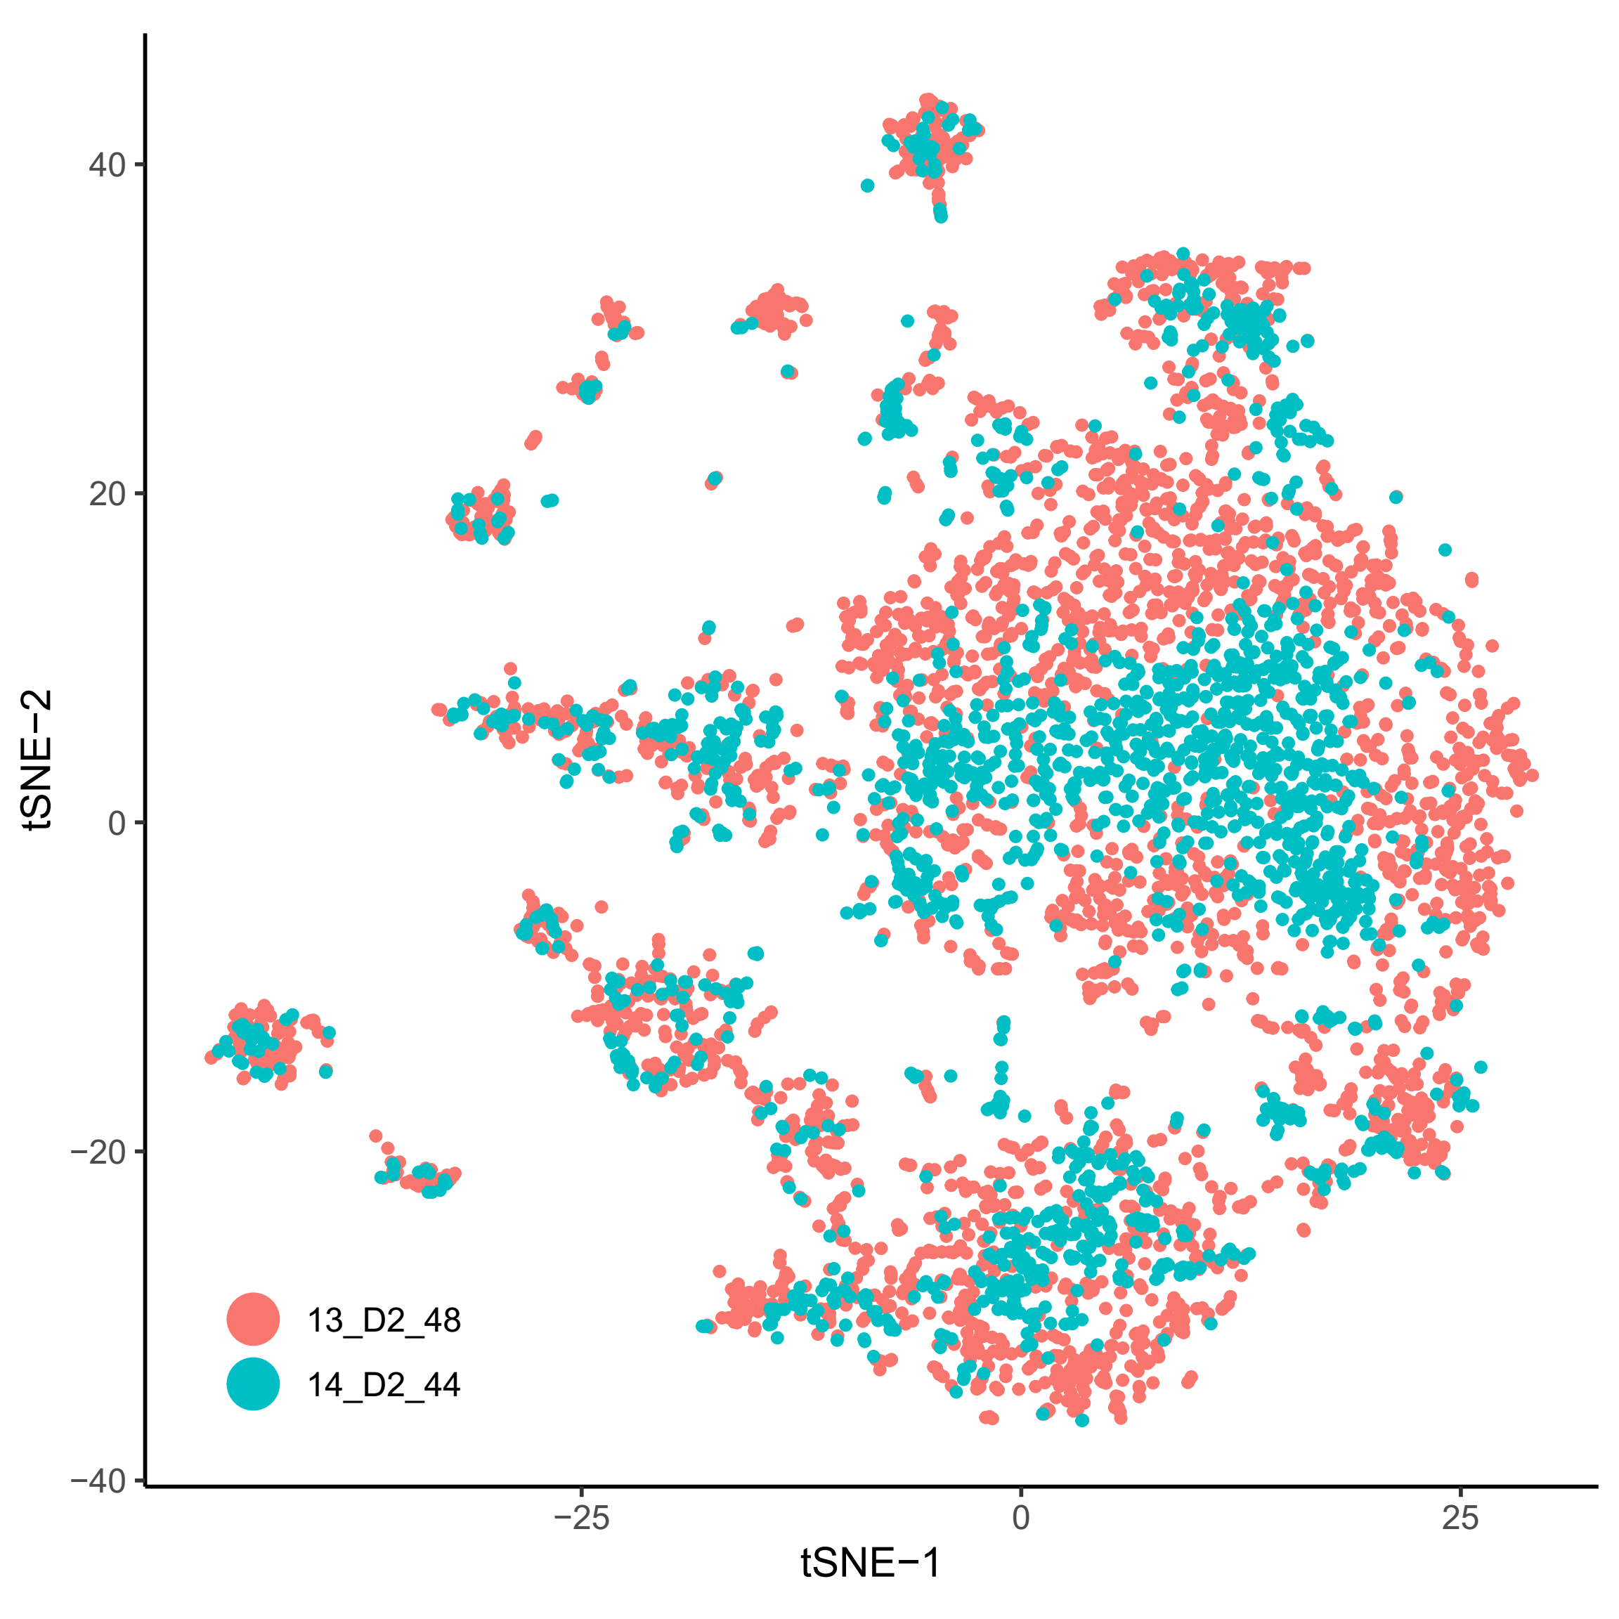
Stomach

Slide 12
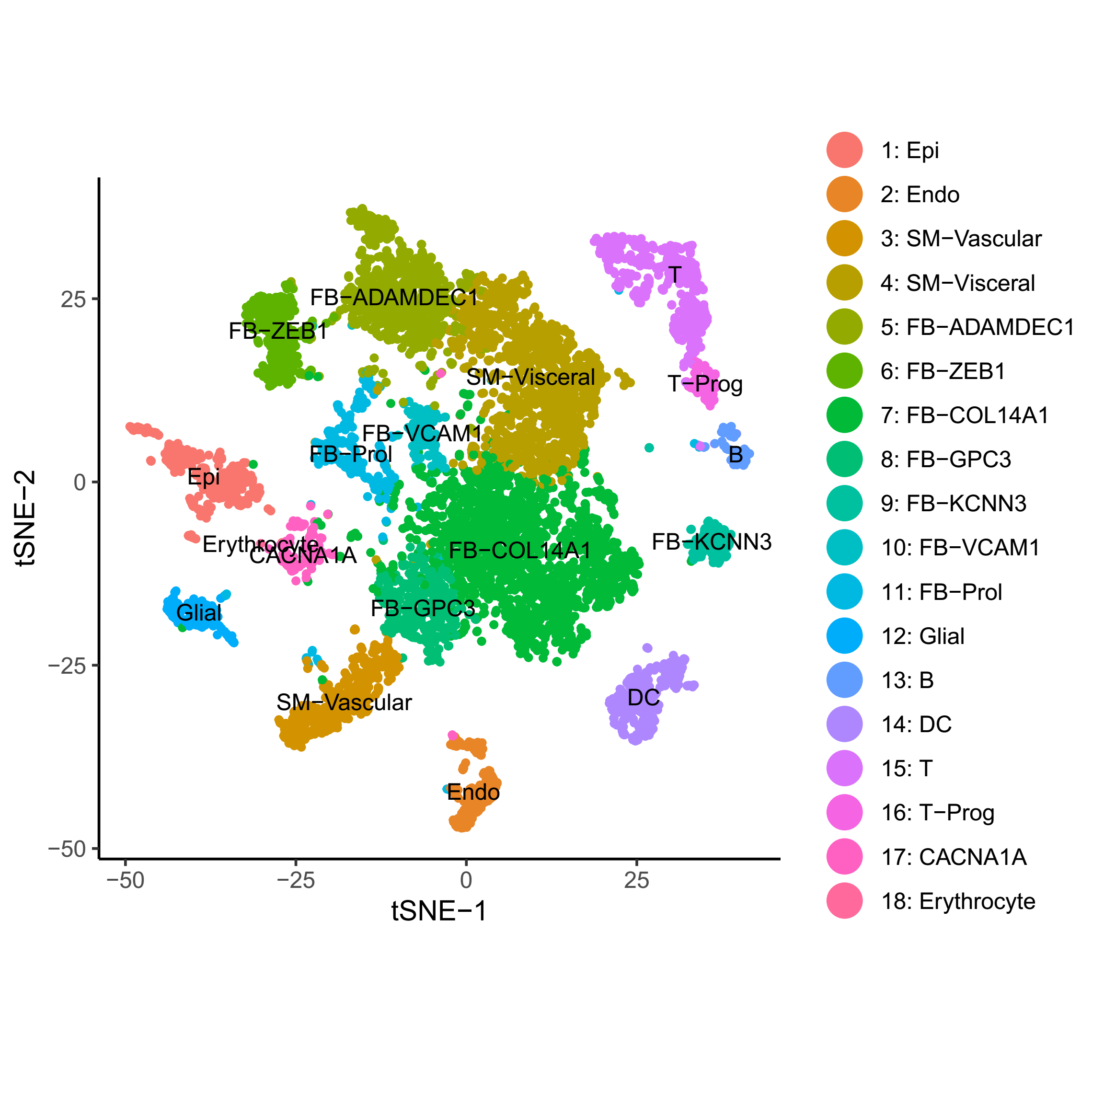
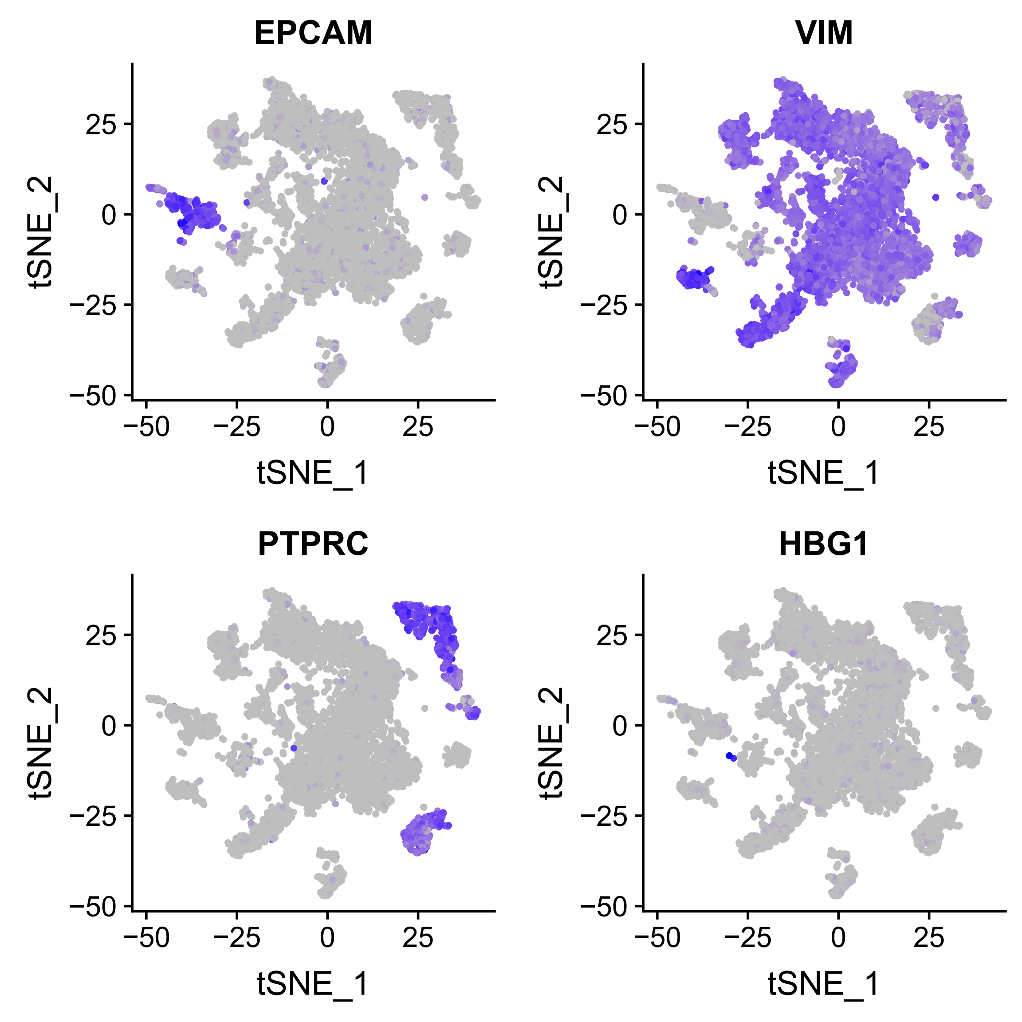
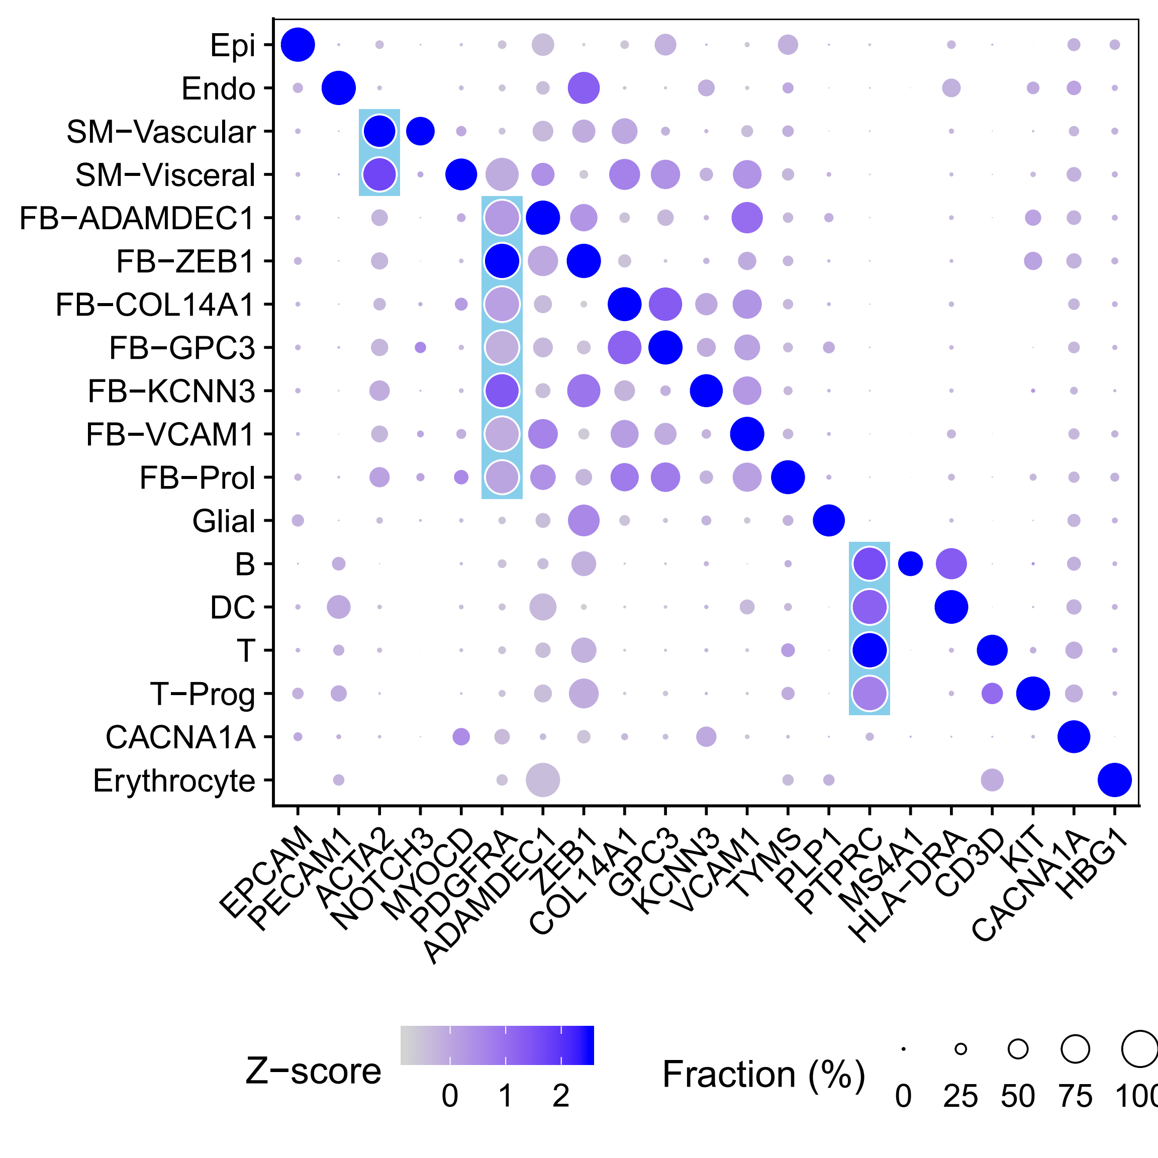
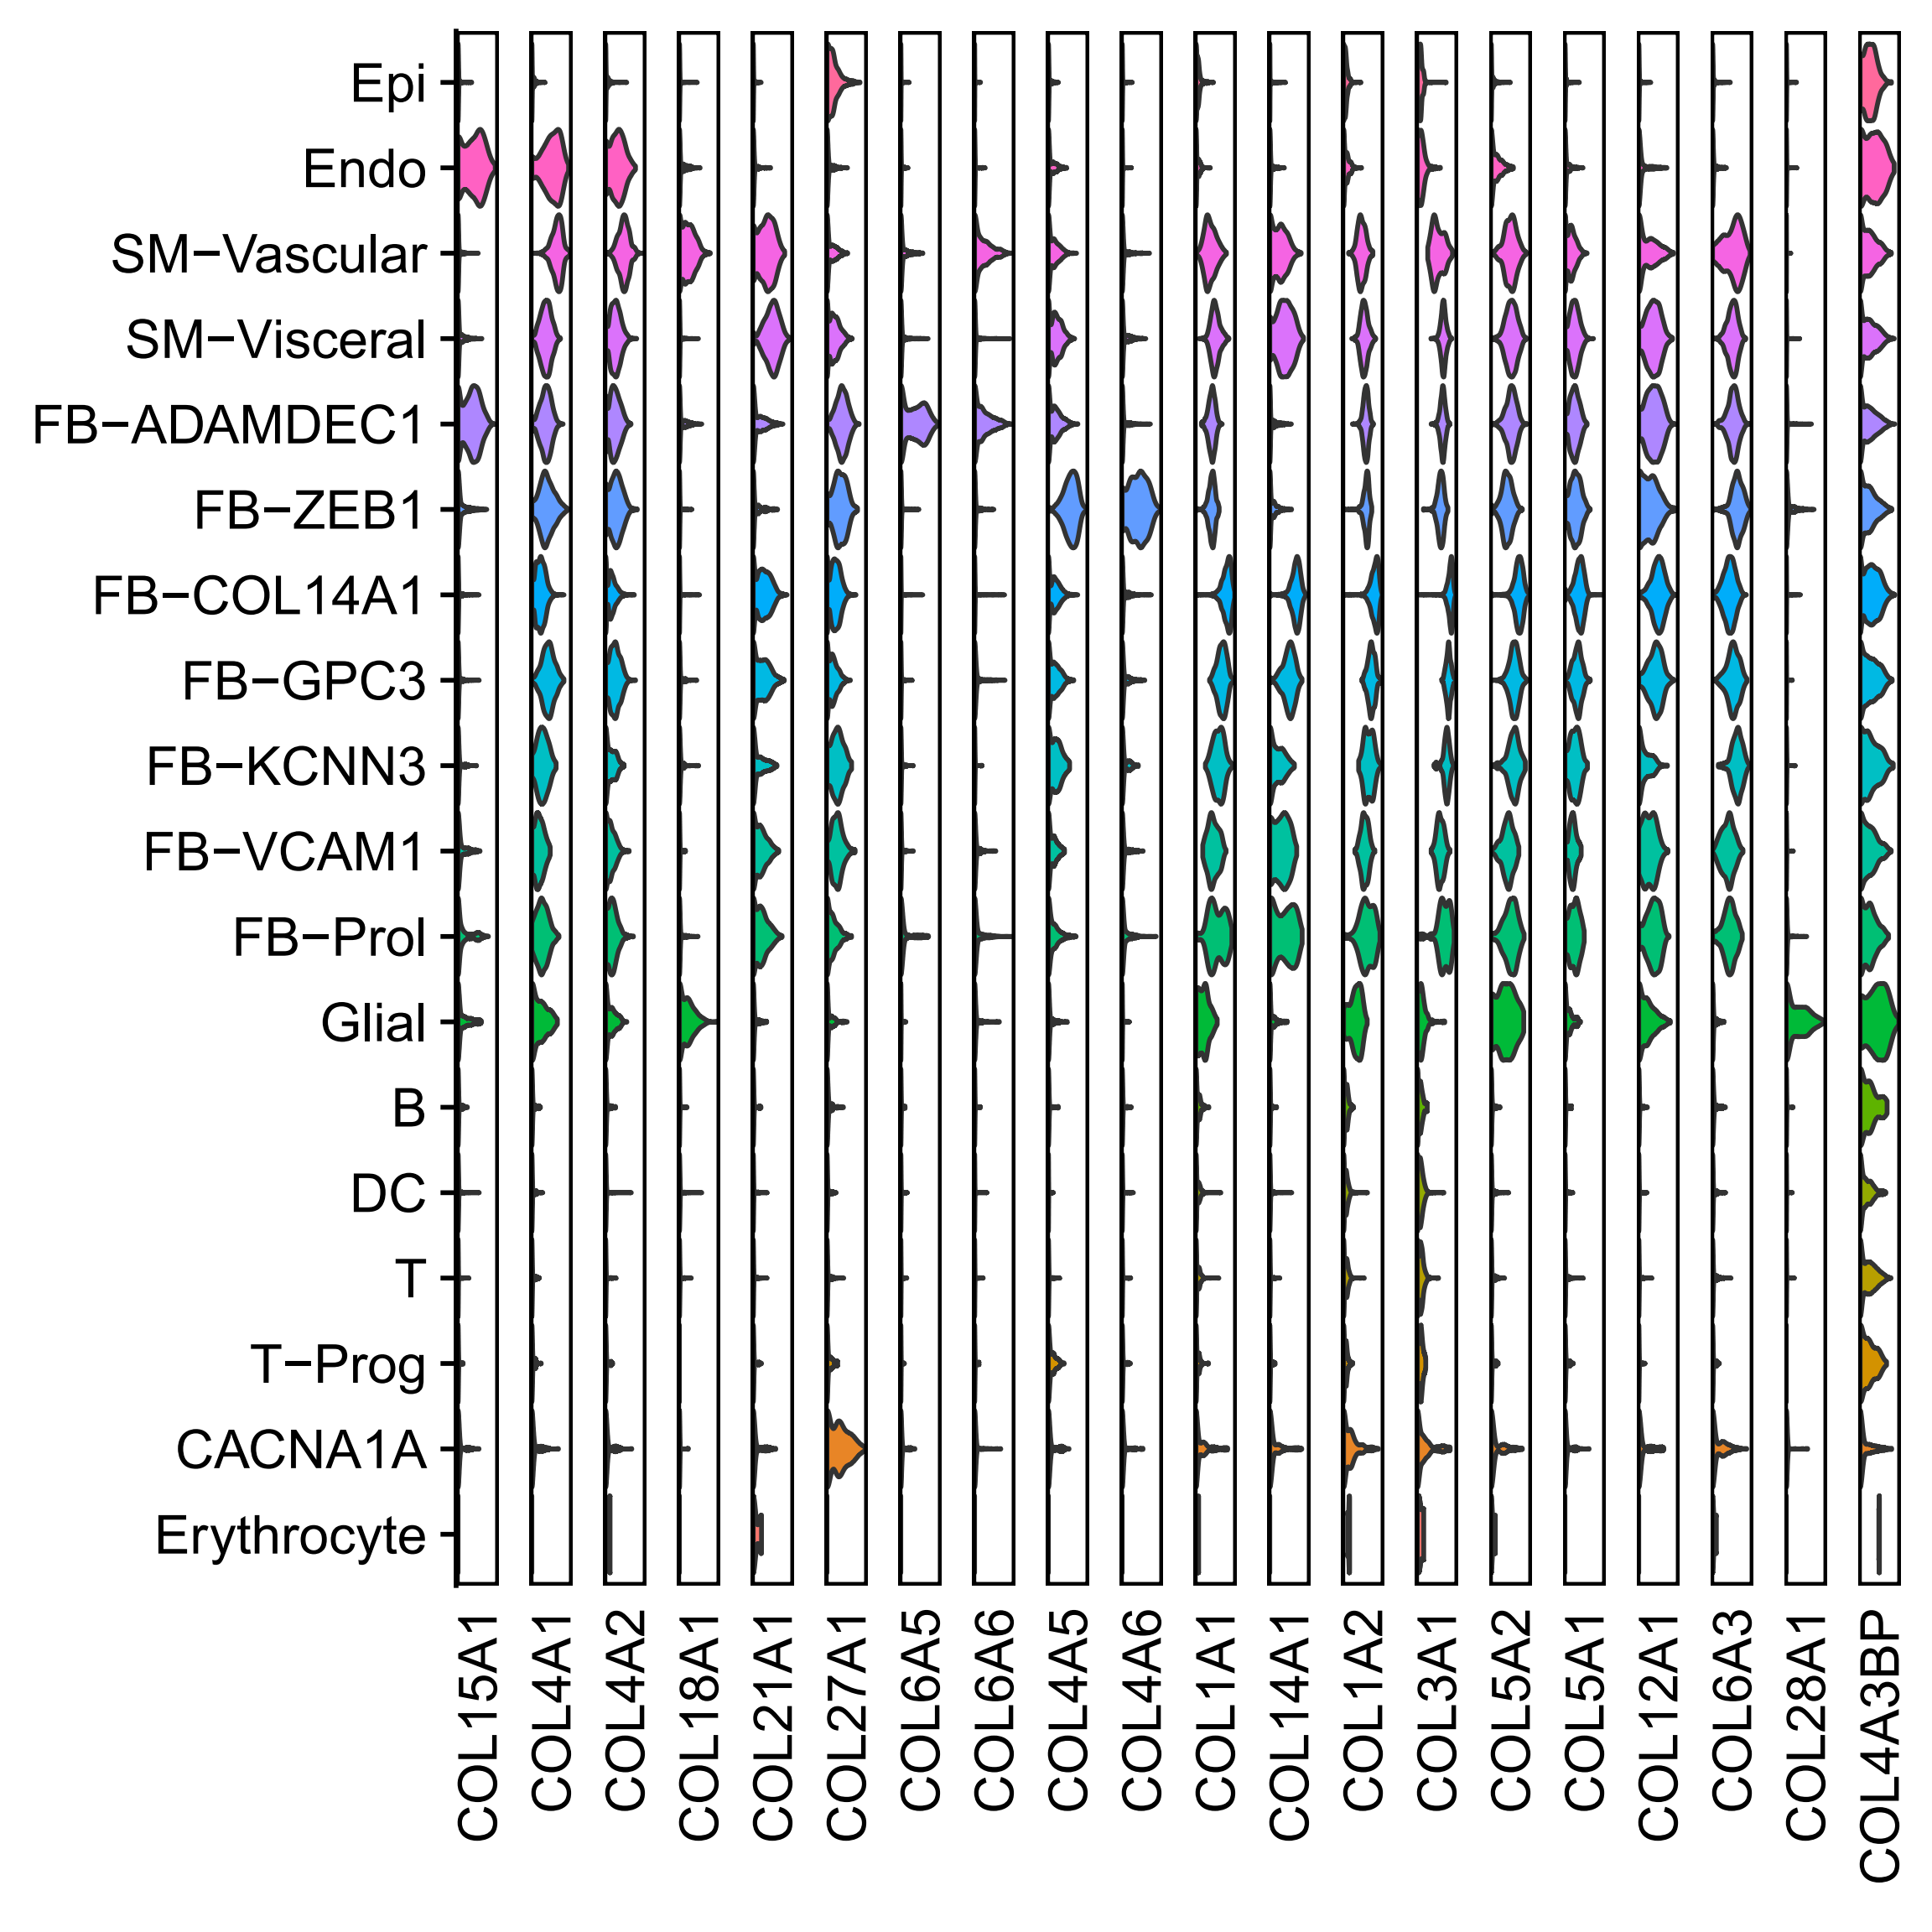
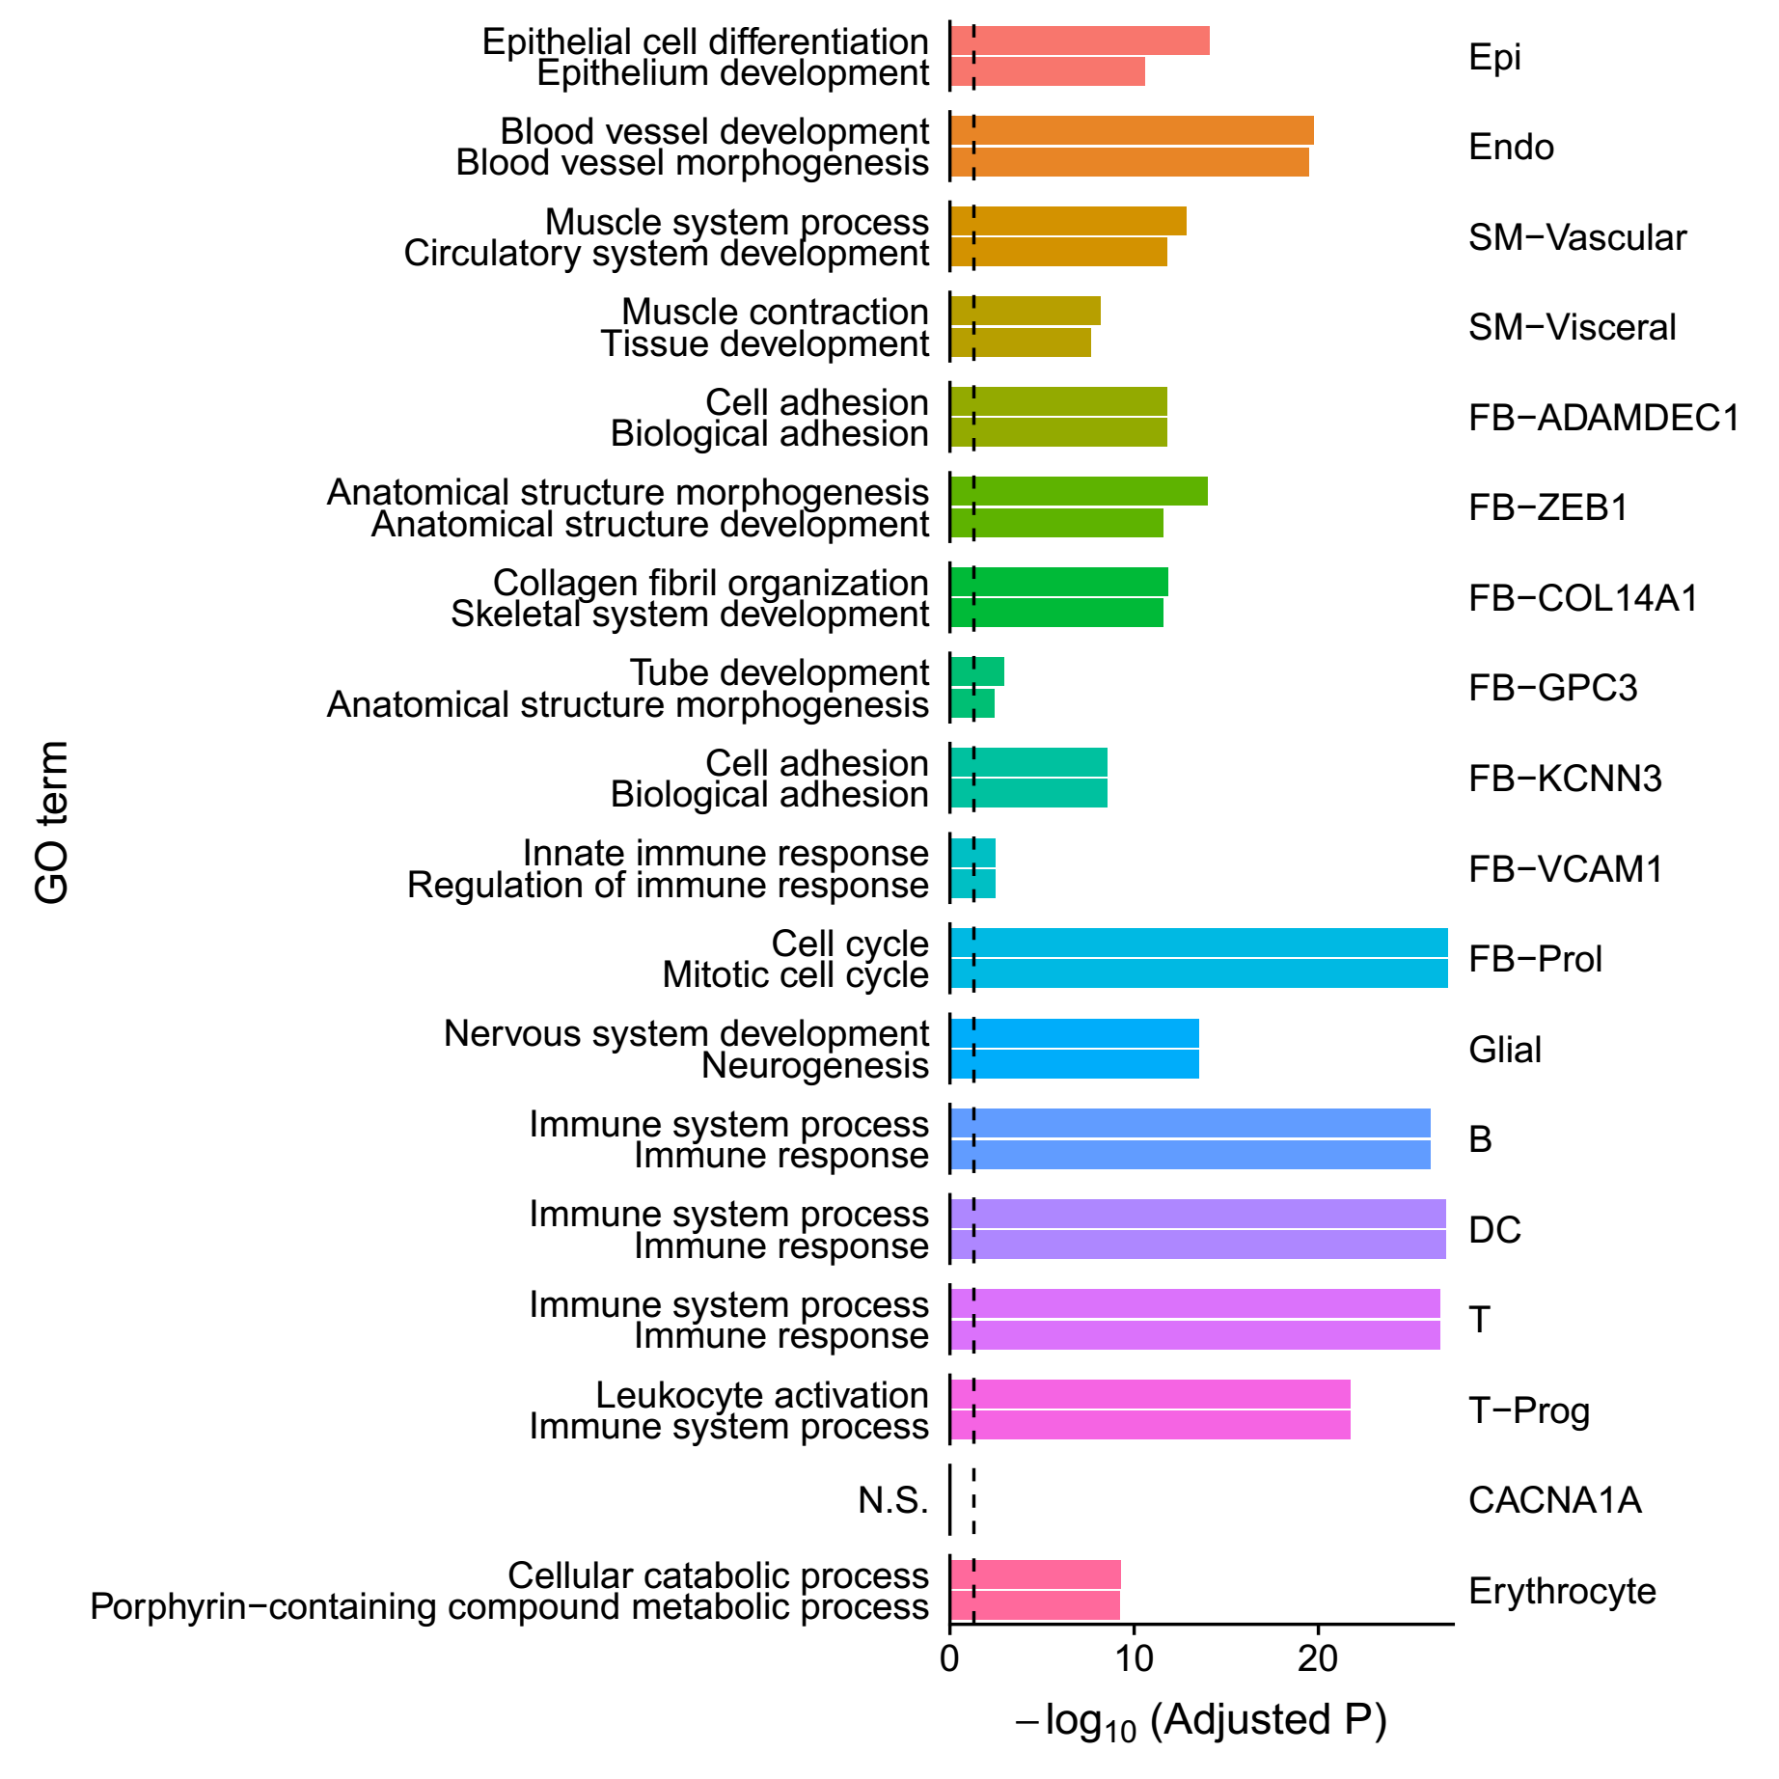
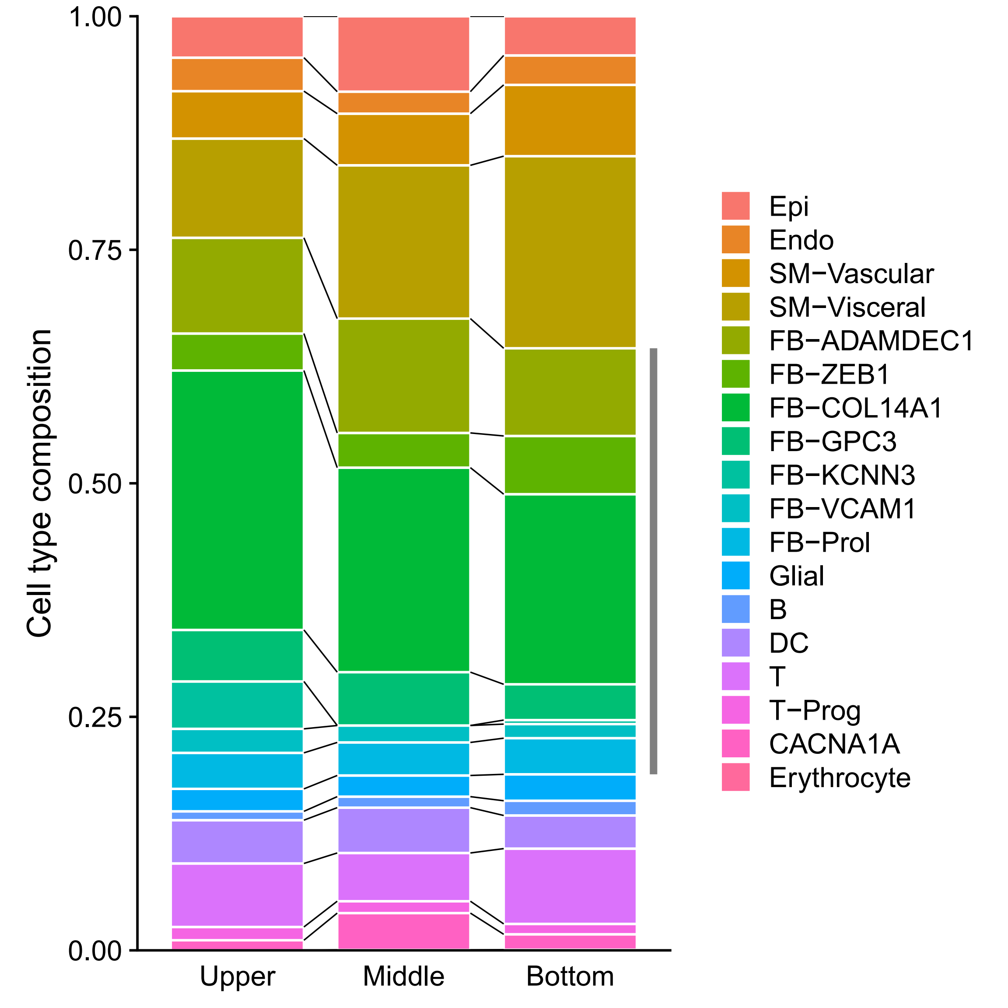
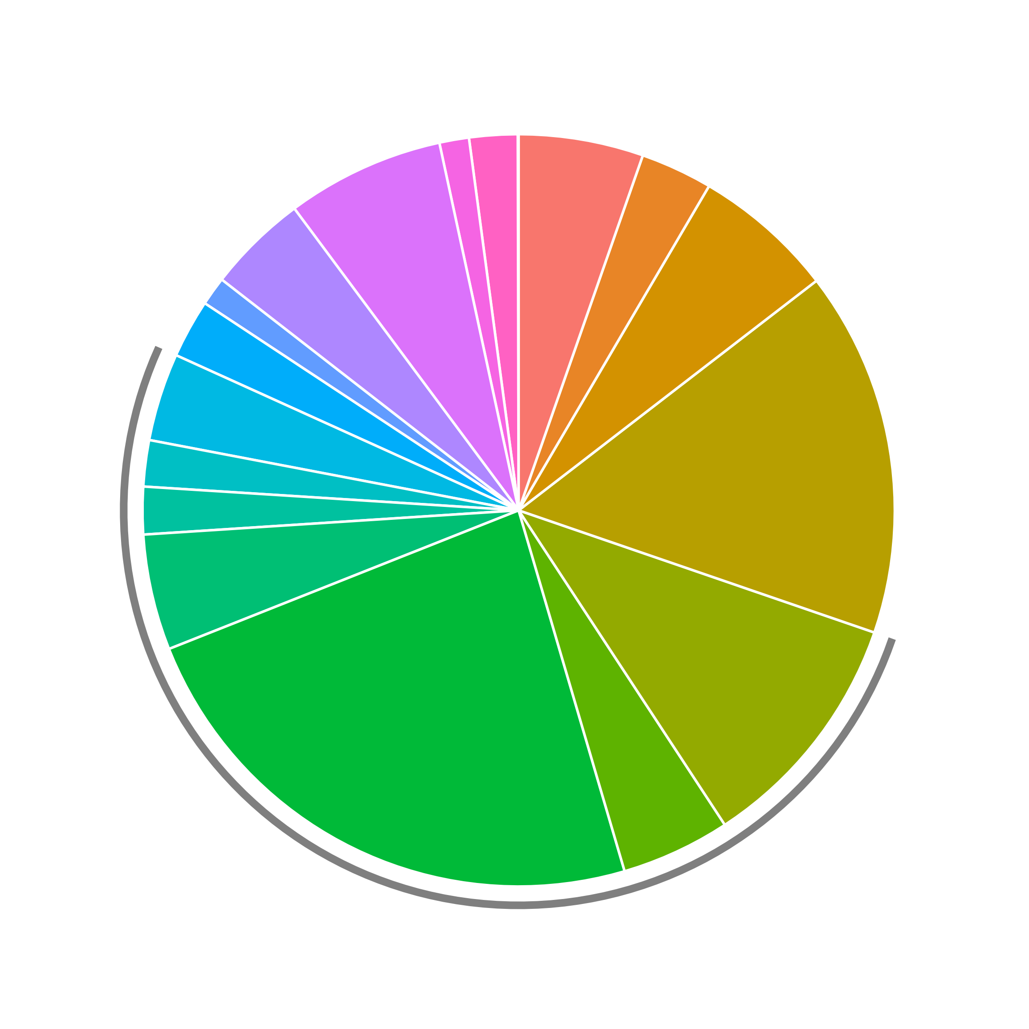
Small intestine

Slide 13
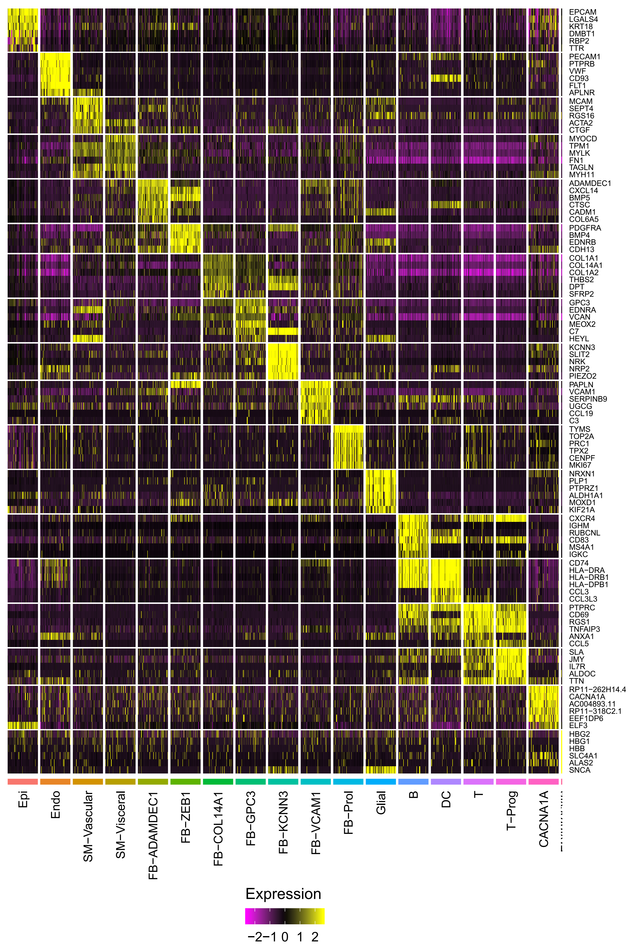
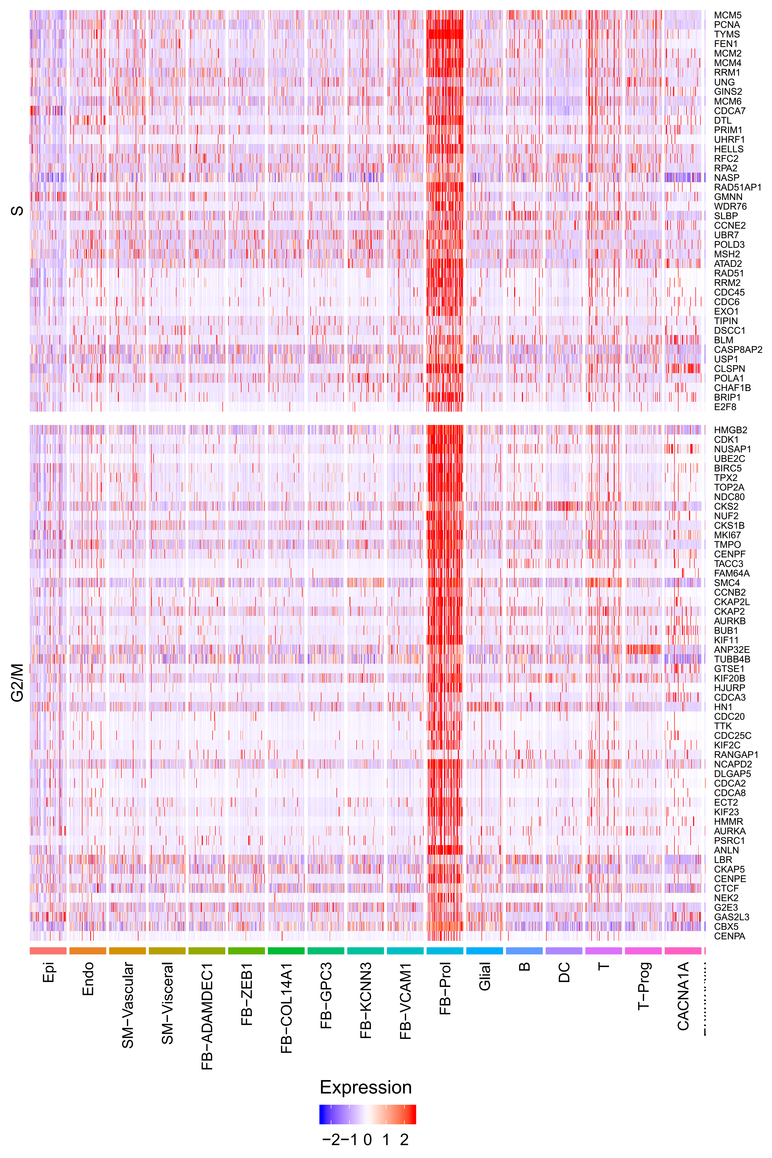
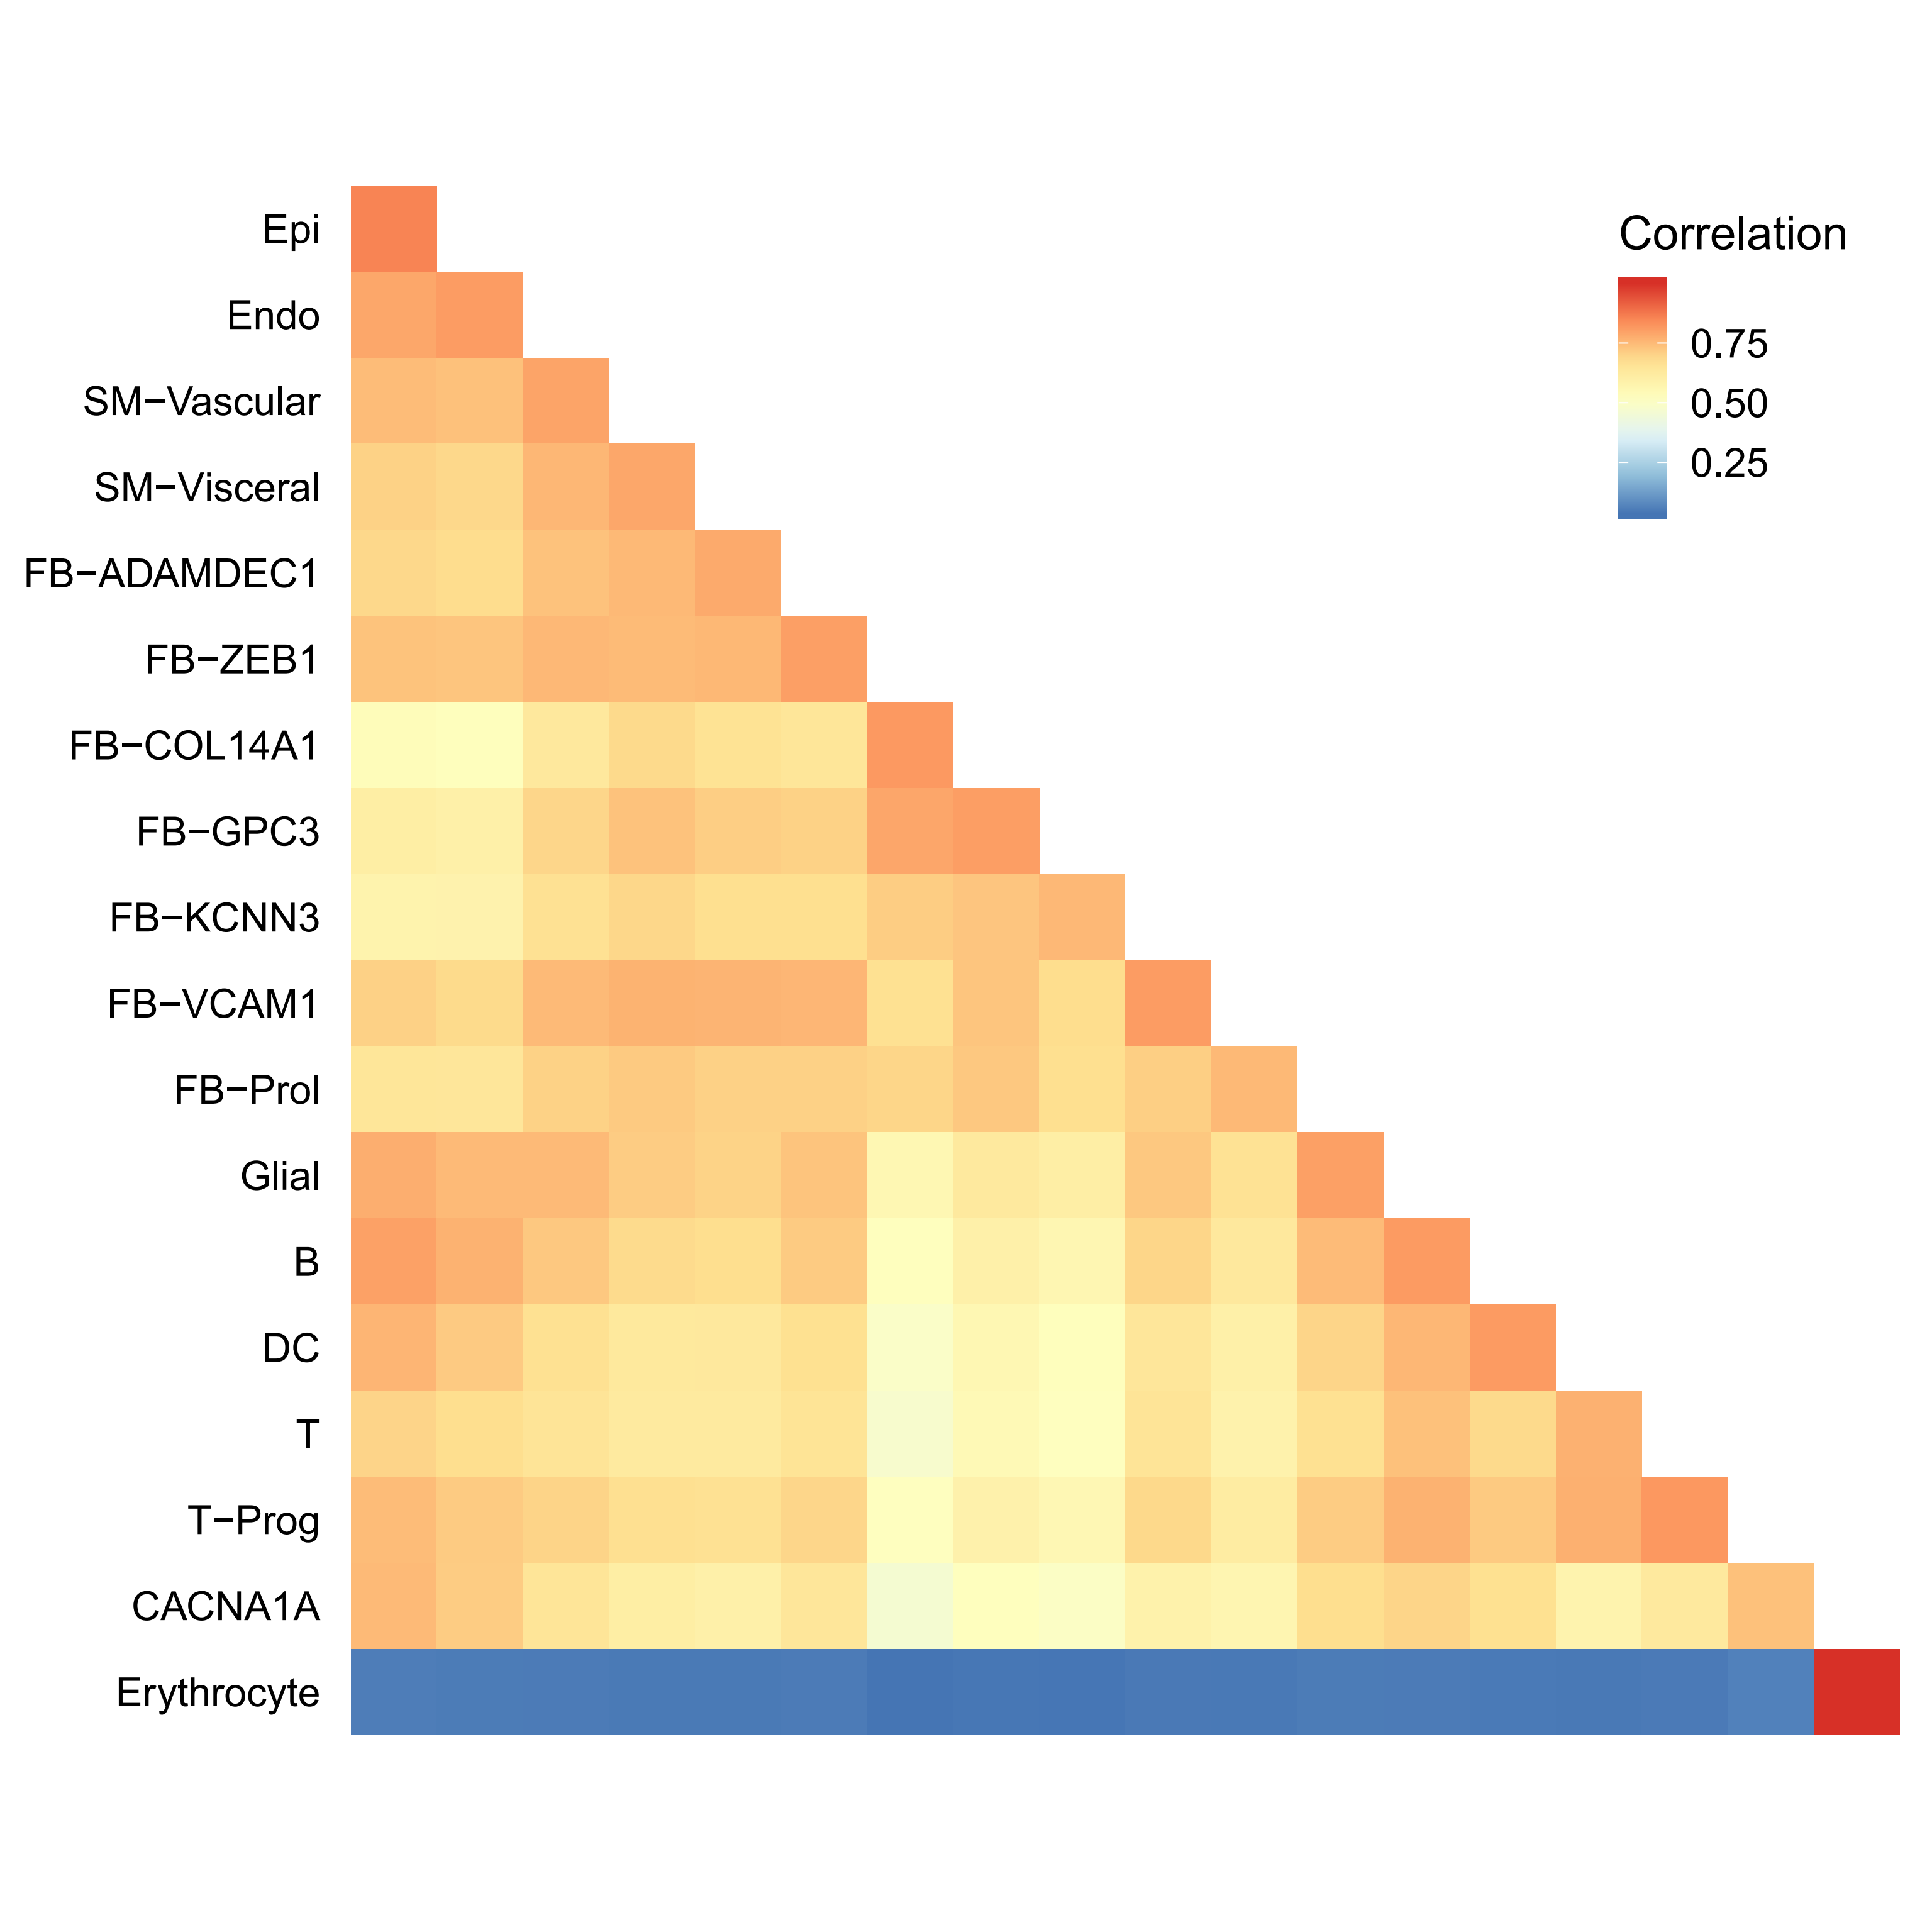
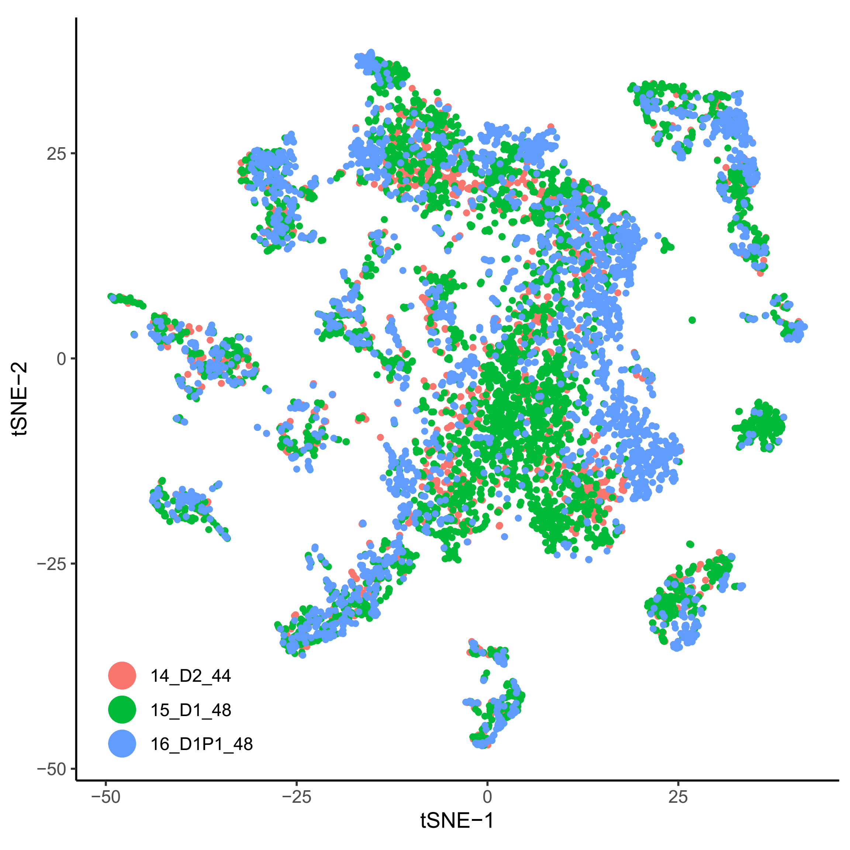
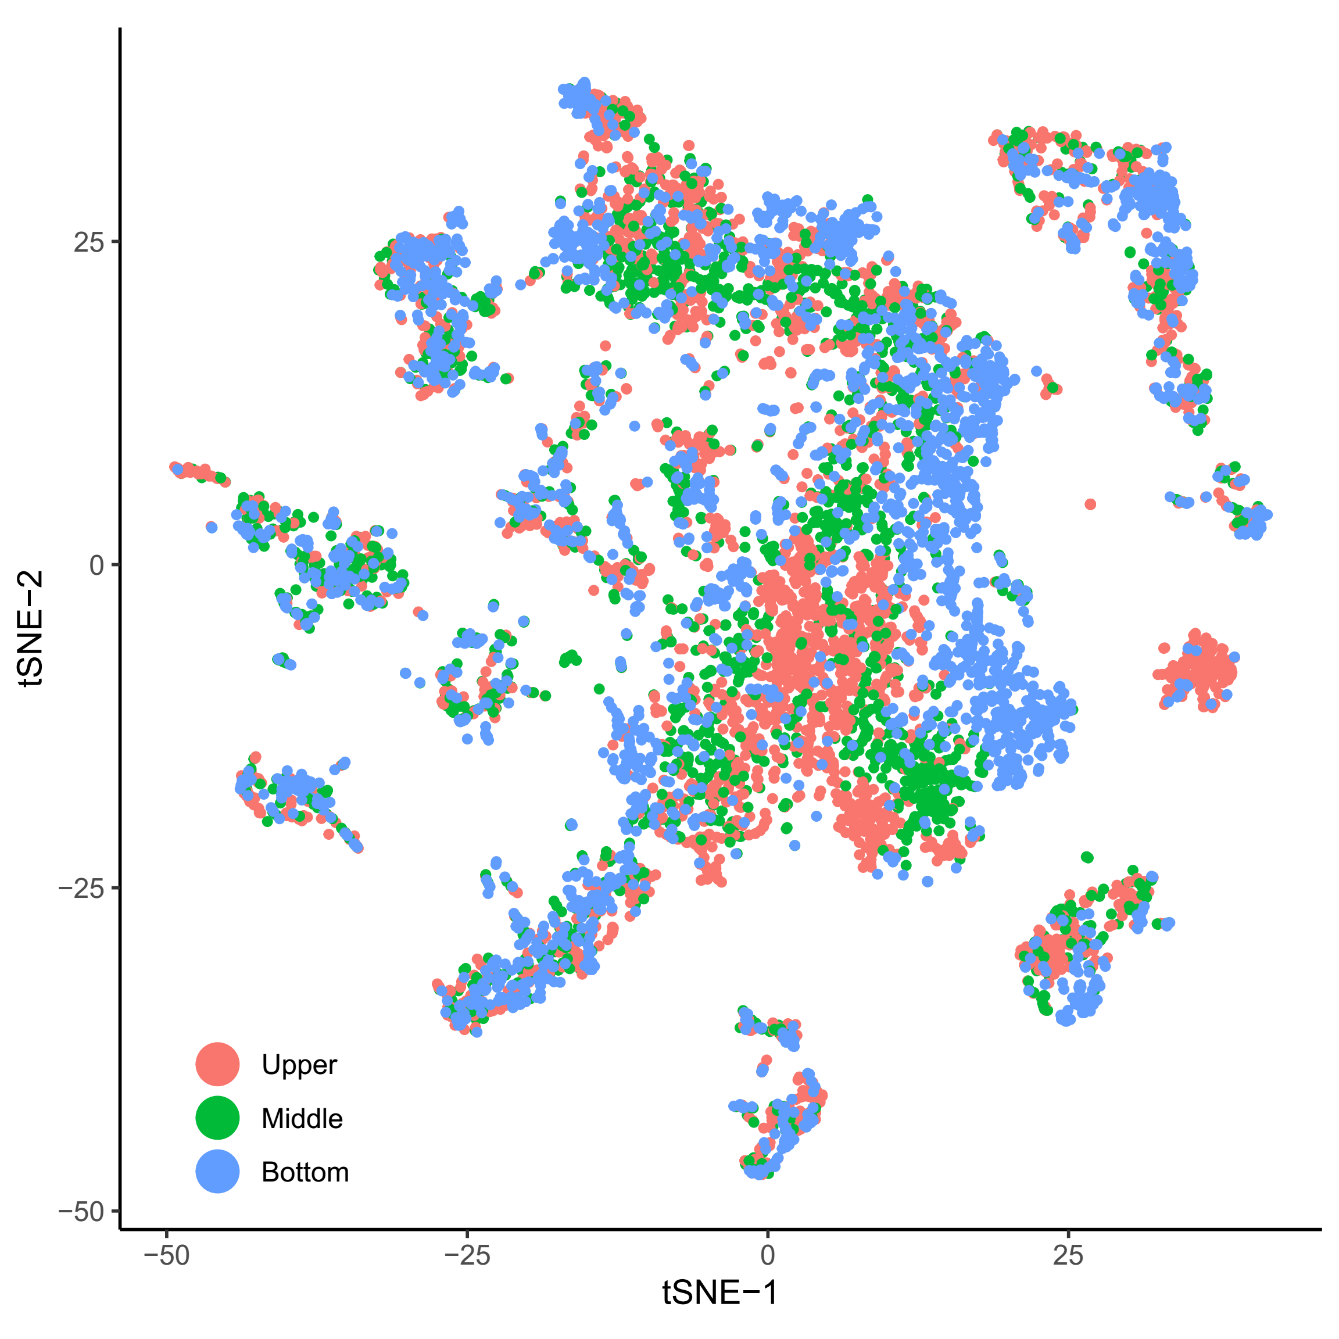
Small intestine

Slide 14







Kidney

Slide 15







Lung
A
B
C
D
E
F

Slide 16




Lung (Supplementary)
A
B
C
D

Slide 17




Lung
A
B
C
D
E
F

Slide 18
Thanks

